Slide 1
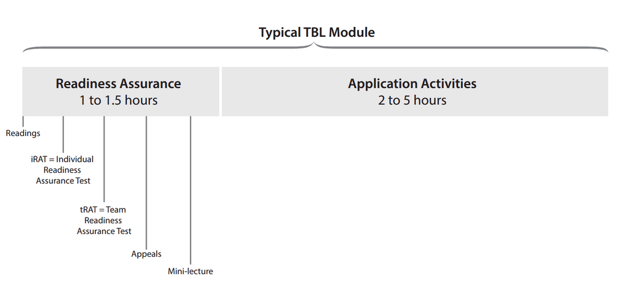

Slide 2
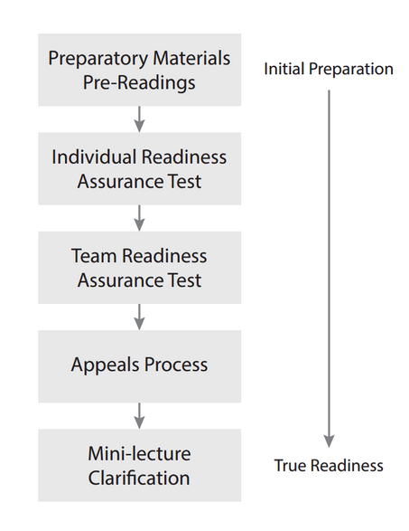

Slide 3


Slide 4
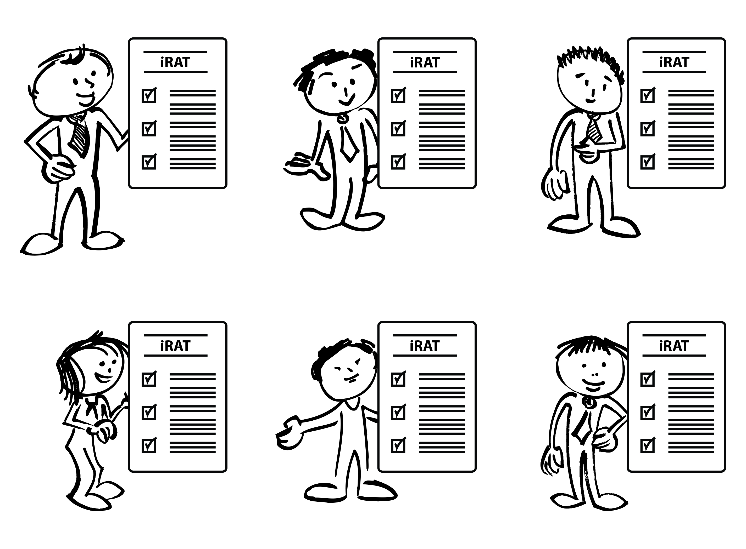

Slide 5
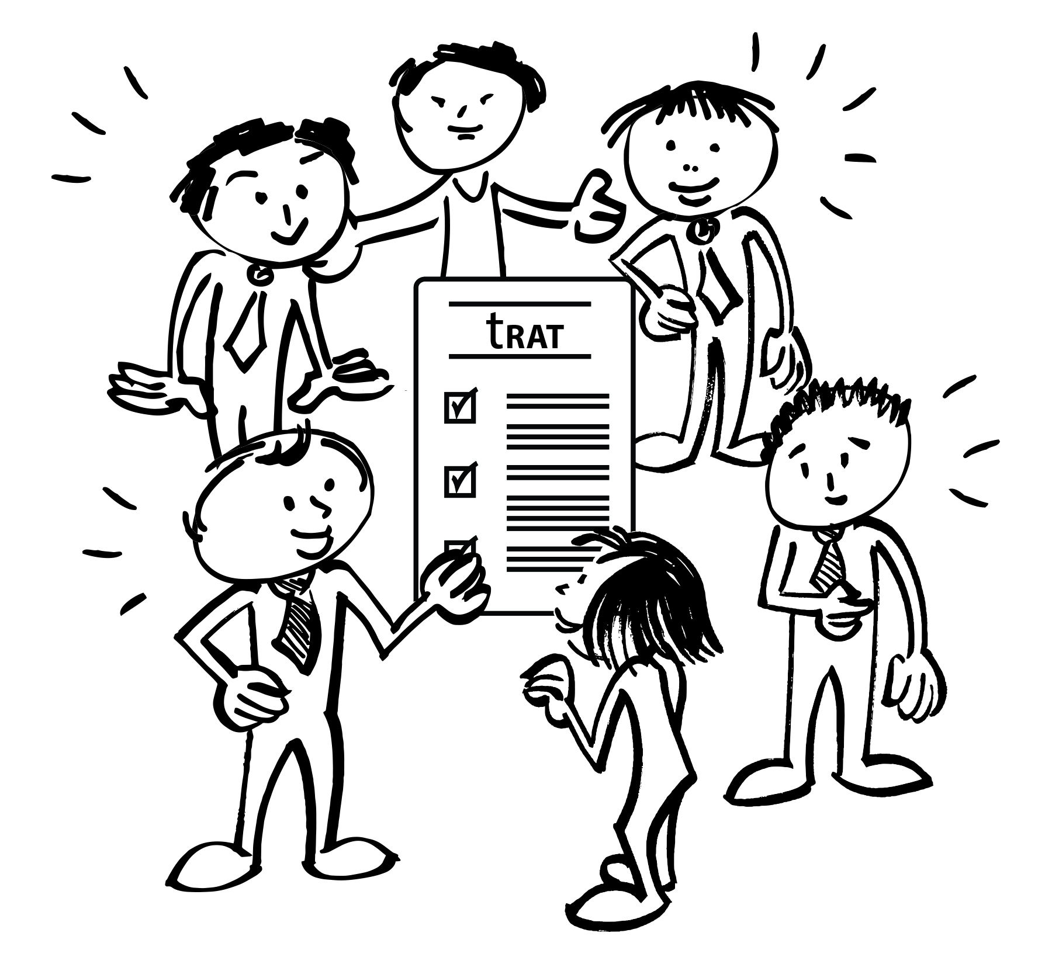

Slide 6
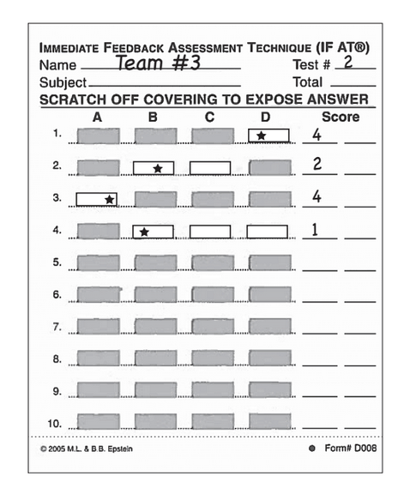
IF-AT’s www.epstienducation.com

Slide 7
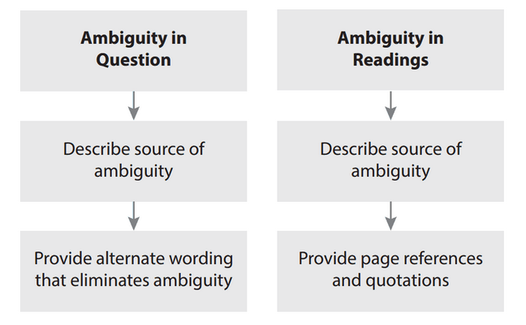
Appeals Process – written scholarly argument, only from teams, and only considered after class – must provide specific evidence – only team that appeals benefits when appeal is accepted

Slide 8
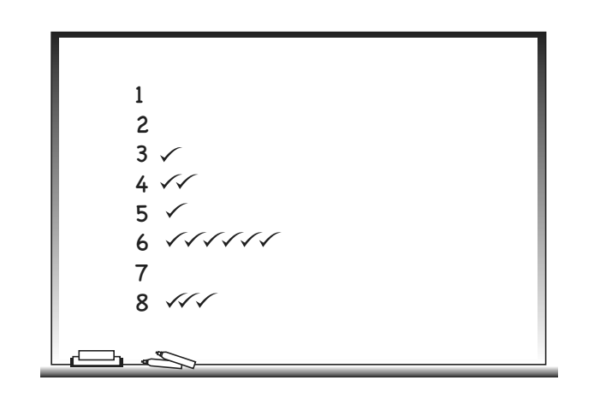

Slide 9
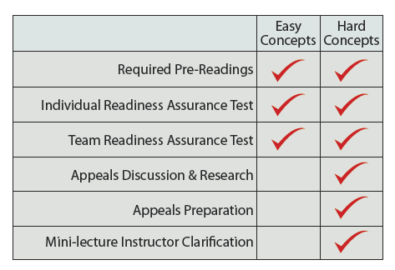
Notes:
Magic of the readiness assurance process
Bob Philpot – South University – “the RAP is about identifying the 10-15% of the content I actually need to talk to students about”

Slide 10
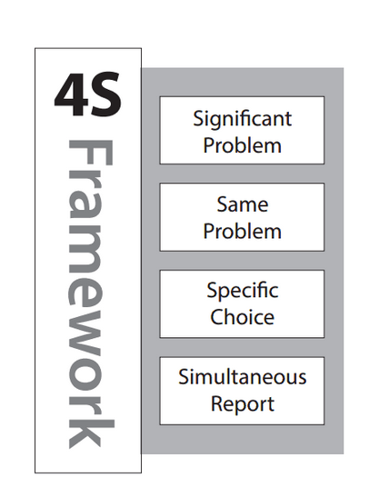

Slide 11

Simultaneous Reporting

Slide 12
Applications and Reporting Options

Slide 13
Simultaneous Reporting

Slide 14
A pharmaceutical company wants to determine whether a sleeping pill is effective. They randomly assign individuals either to take a sleeping pill or to take a placebo. They compare the amount of time participants are asleep. They hypothesize the sleeping pill group will sleep longer than the placebo group.
  a. Chi-square goodness of fit test
  b. Contingency table analysis (chi-square test of independence)
  c. This can’t be analyzed using a chi-square!!
Source: Marie Thomas

Slide 15
A patient with a Brain Stem Stroke has collapsed a lung from intractable hiccups and feed-tube aspirates. He was admitted to intensive care to deal with the subsequent pneumonia. A few weeks later he is moved to a regular ward and the PRN order for Baclofen has expired (Baclofen, Gabapentin family of drugs - off label use to control intractable hiccups). The patient has begun to hiccup again and is growing increasingly distressed that nothing is being done. The patient’s wife has repeatedly come to the nurse’s station demanding action. It is Friday night of a long weekend and the doctor on call is not returning the page. The Doctor had made is very clear to the nurses, that he is not to be called. It appears to be a doctor oversight that it was not renewed. The wife persistently demands action and the nurse begins to cry. The head nurse intervenes.
The head nurse should:
  Do nothing, but continue to attempt to contact the doctor
  Give the patient the pill and note it in the chart
  Give the pill, chart it, and continue calling the doctor
  Mark a pill as spoiled and leave it with the patient

Slide 16
The blood was drawn from the men in the fed state. Which one of the statements below provides the best support for their being in the fed state?
  A. Glucagon levels in the men are too high to indicate the fasted state.
  B. Glucose levels in the men are the strongest indicators of the fed state.
  C. The observed levels of liver synthesized plasma proteins albumin and transferrin are diagnostic for the fed state.
  D. Low levels of free fatty acids and ketone bodies (acetoacetate and β-OH butyrate) coupled with relatively high levels of insulin suggest the fed state.
  E. The RQ near 1 rules out vigorous exercise and must be related to the fed state.

Slide 17

Small Whiteboards

Slide 18
A patient come into emergency with the following symptoms...
  What is the first thing you would do? And why?
  B. What is the first test you would order? And why?
  C. What would be the worst thing to do? And why?

Slide 19
You are consulting for a new business owner who wants to open a dry-cleaning store in Norman, Oklahoma. Where would you recommend locating a new dry-cleaning business (and why)?

Slide 20
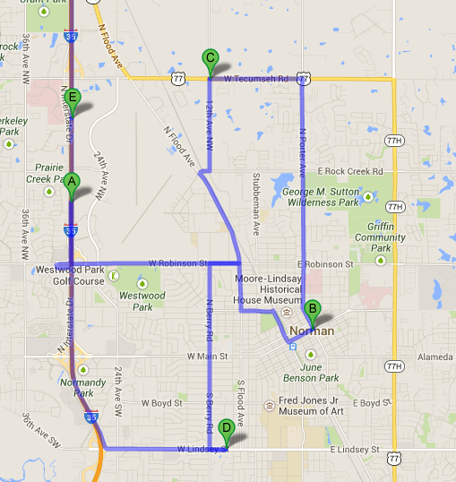
Push Pin in Map

Slide 21
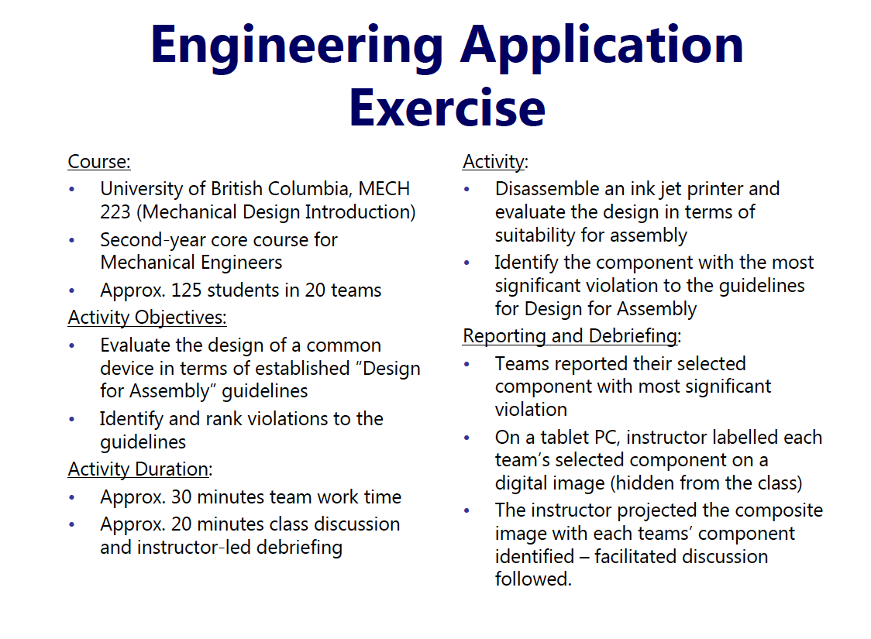

Slide 22
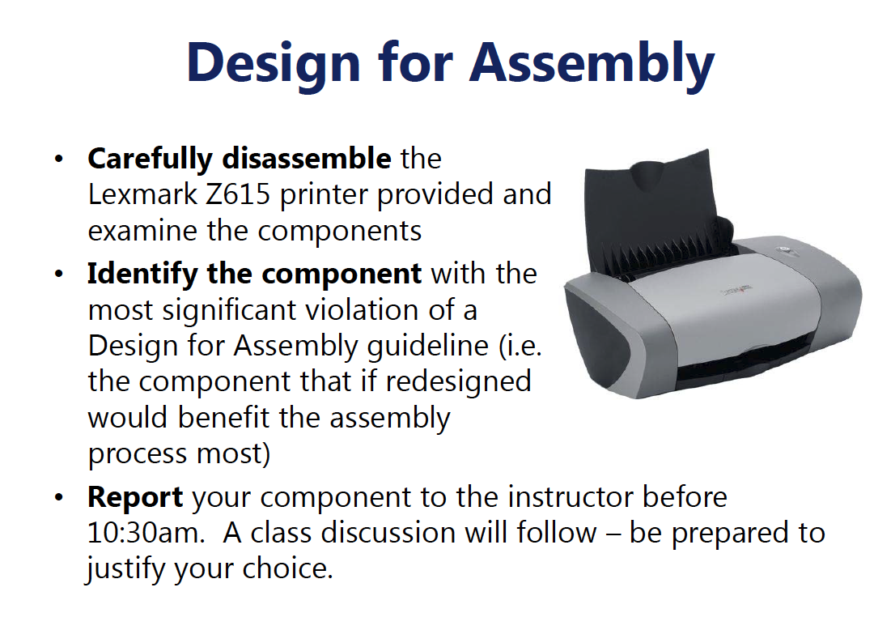

Slide 23
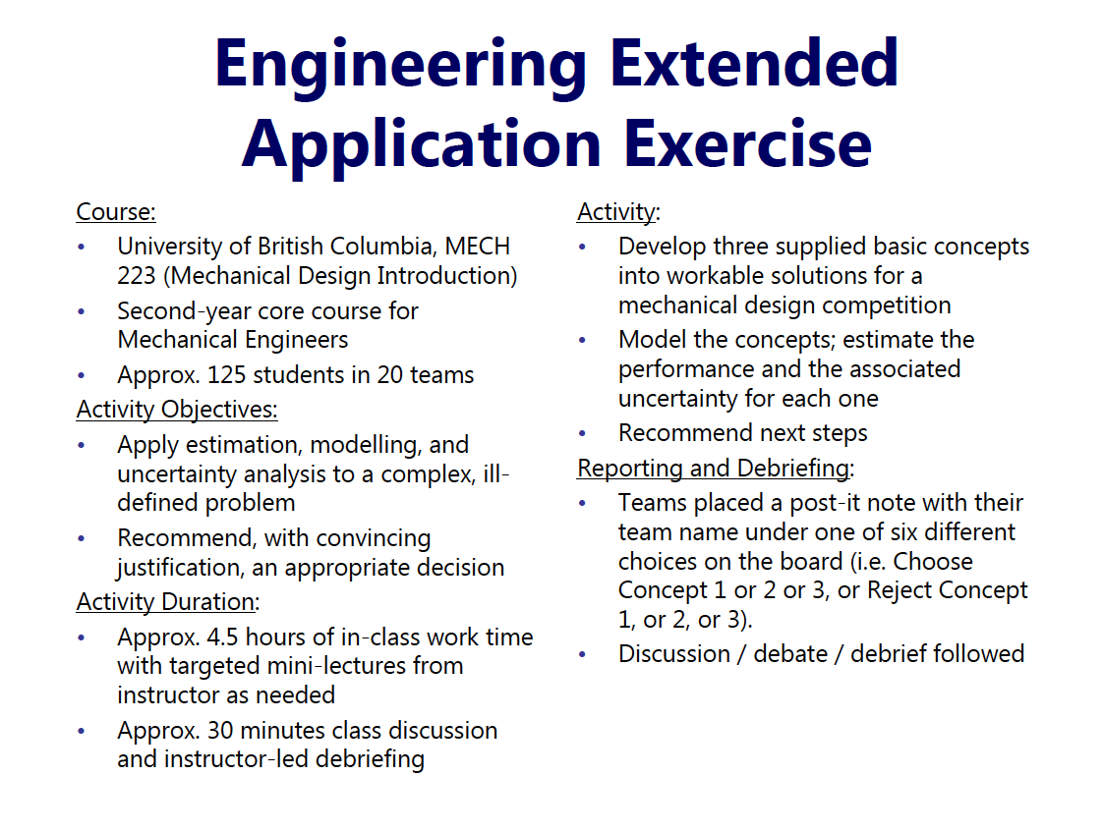

Slide 24
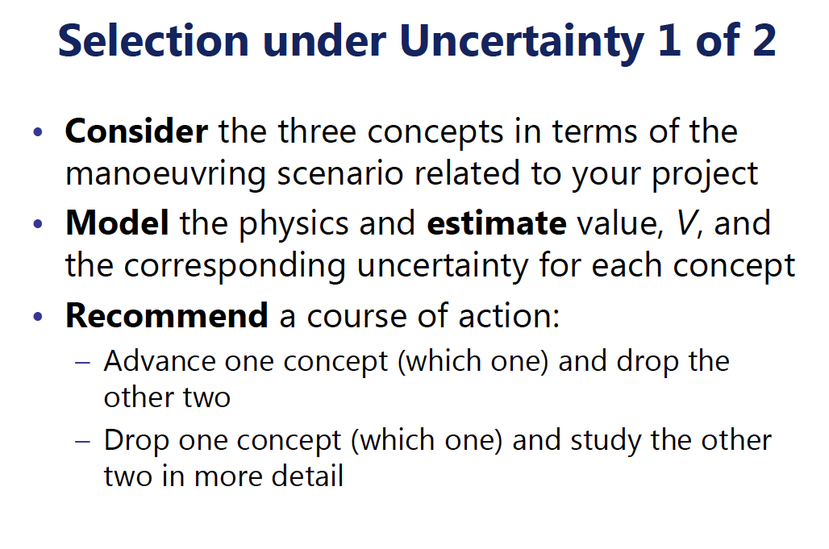

Slide 25
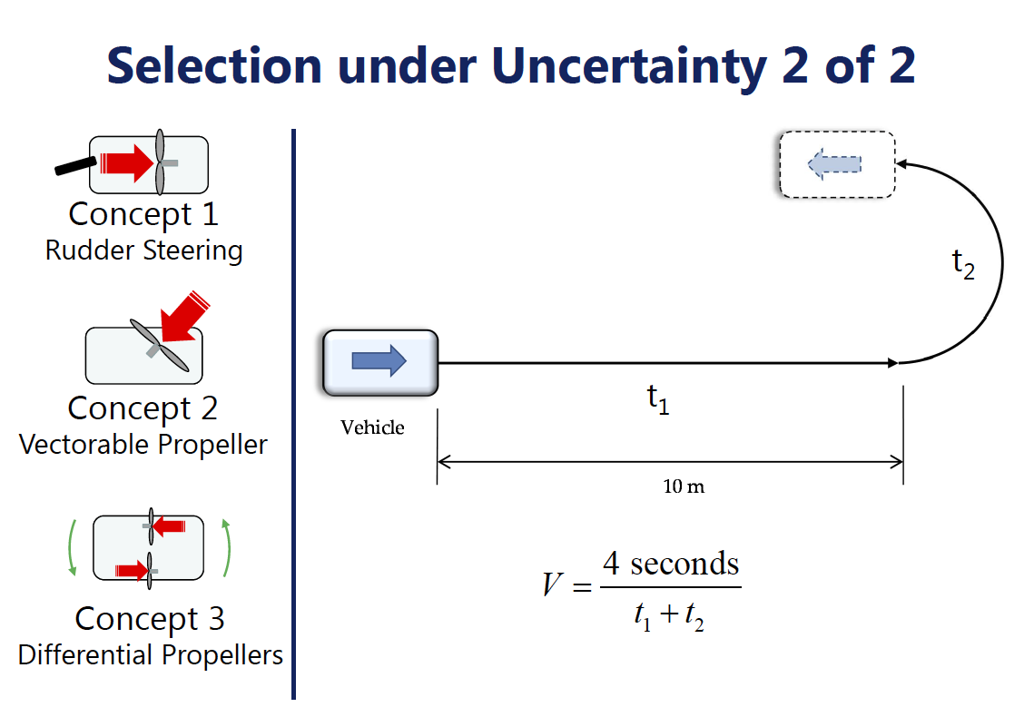

Slide 26
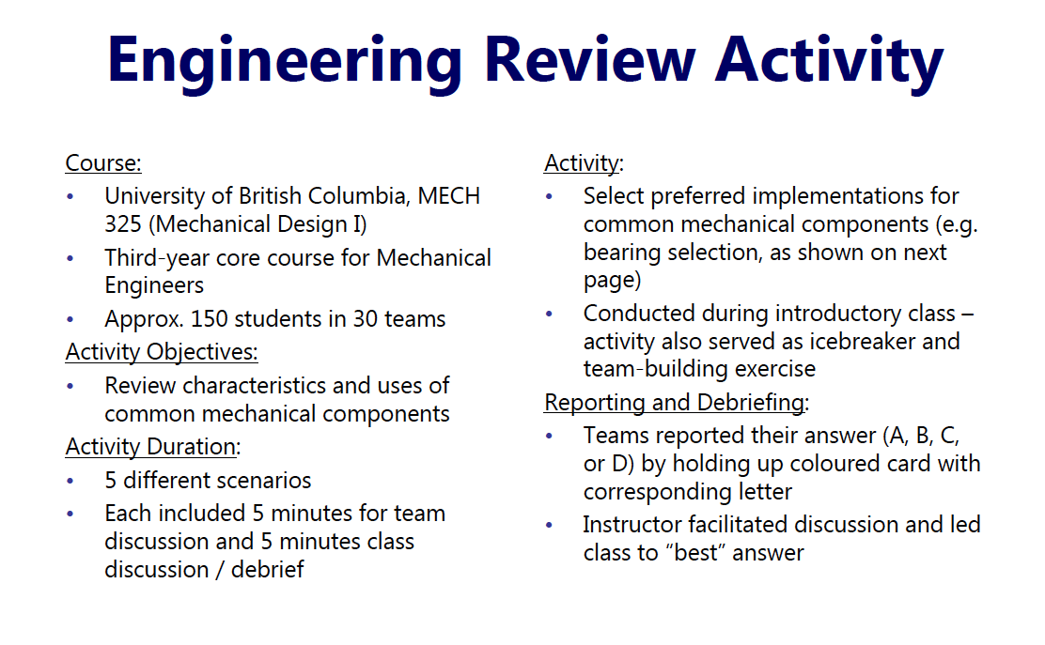

Slide 27
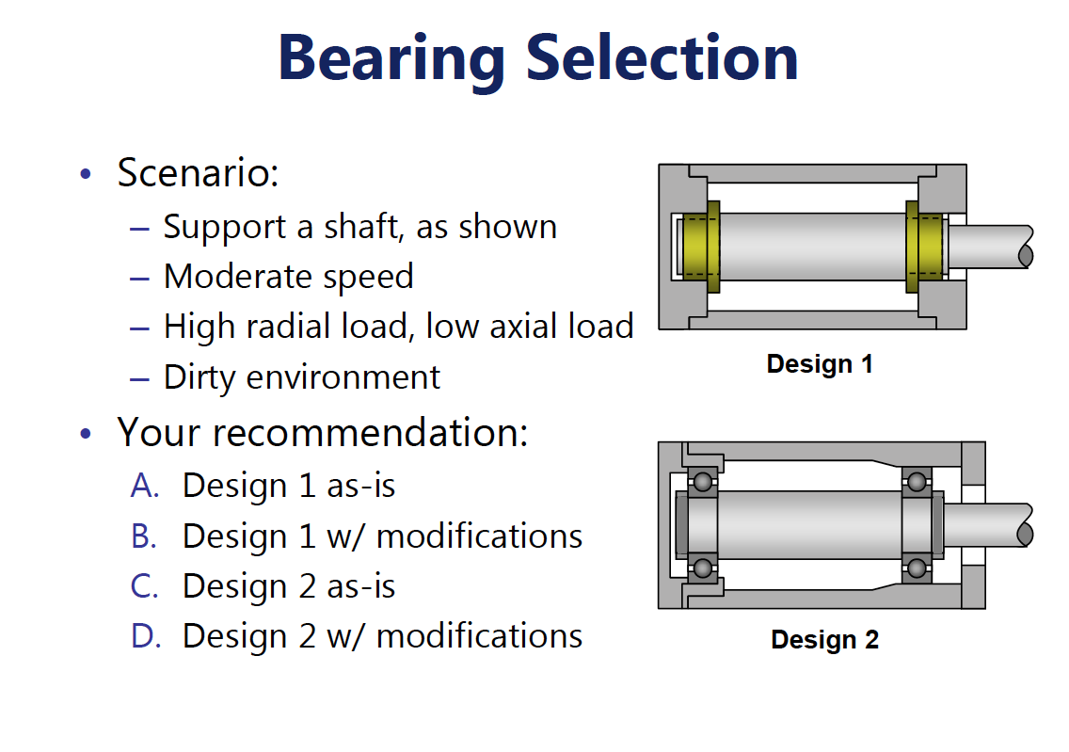

Slide 28
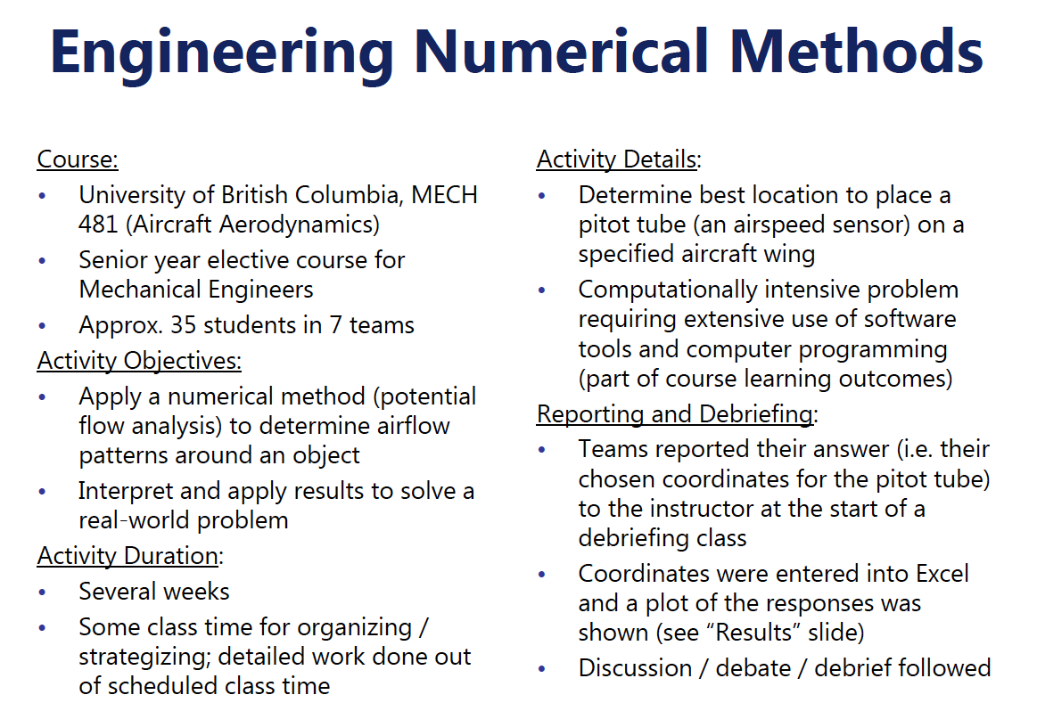
Excel - Part 1

Slide 29
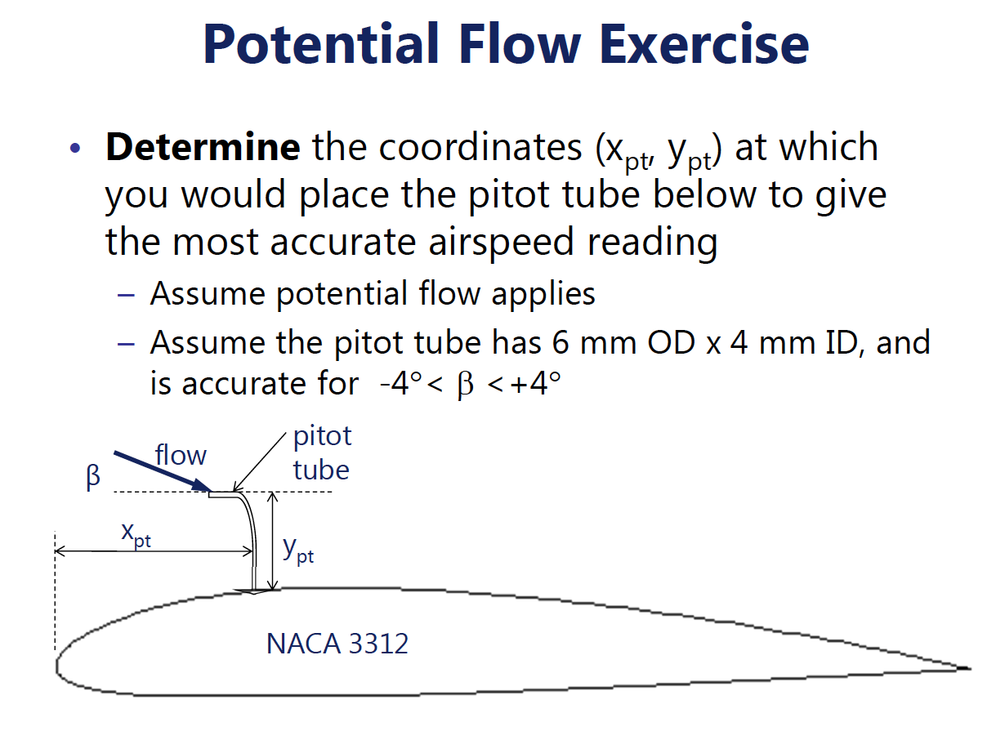
Excel - Part 2

Slide 30
Excel Reporting
Instructor enters numerical positions then displays all at once
One page summary– principles and approach and not calculations (16 pt font or bigger)
Excel – Part 3

Slide 31
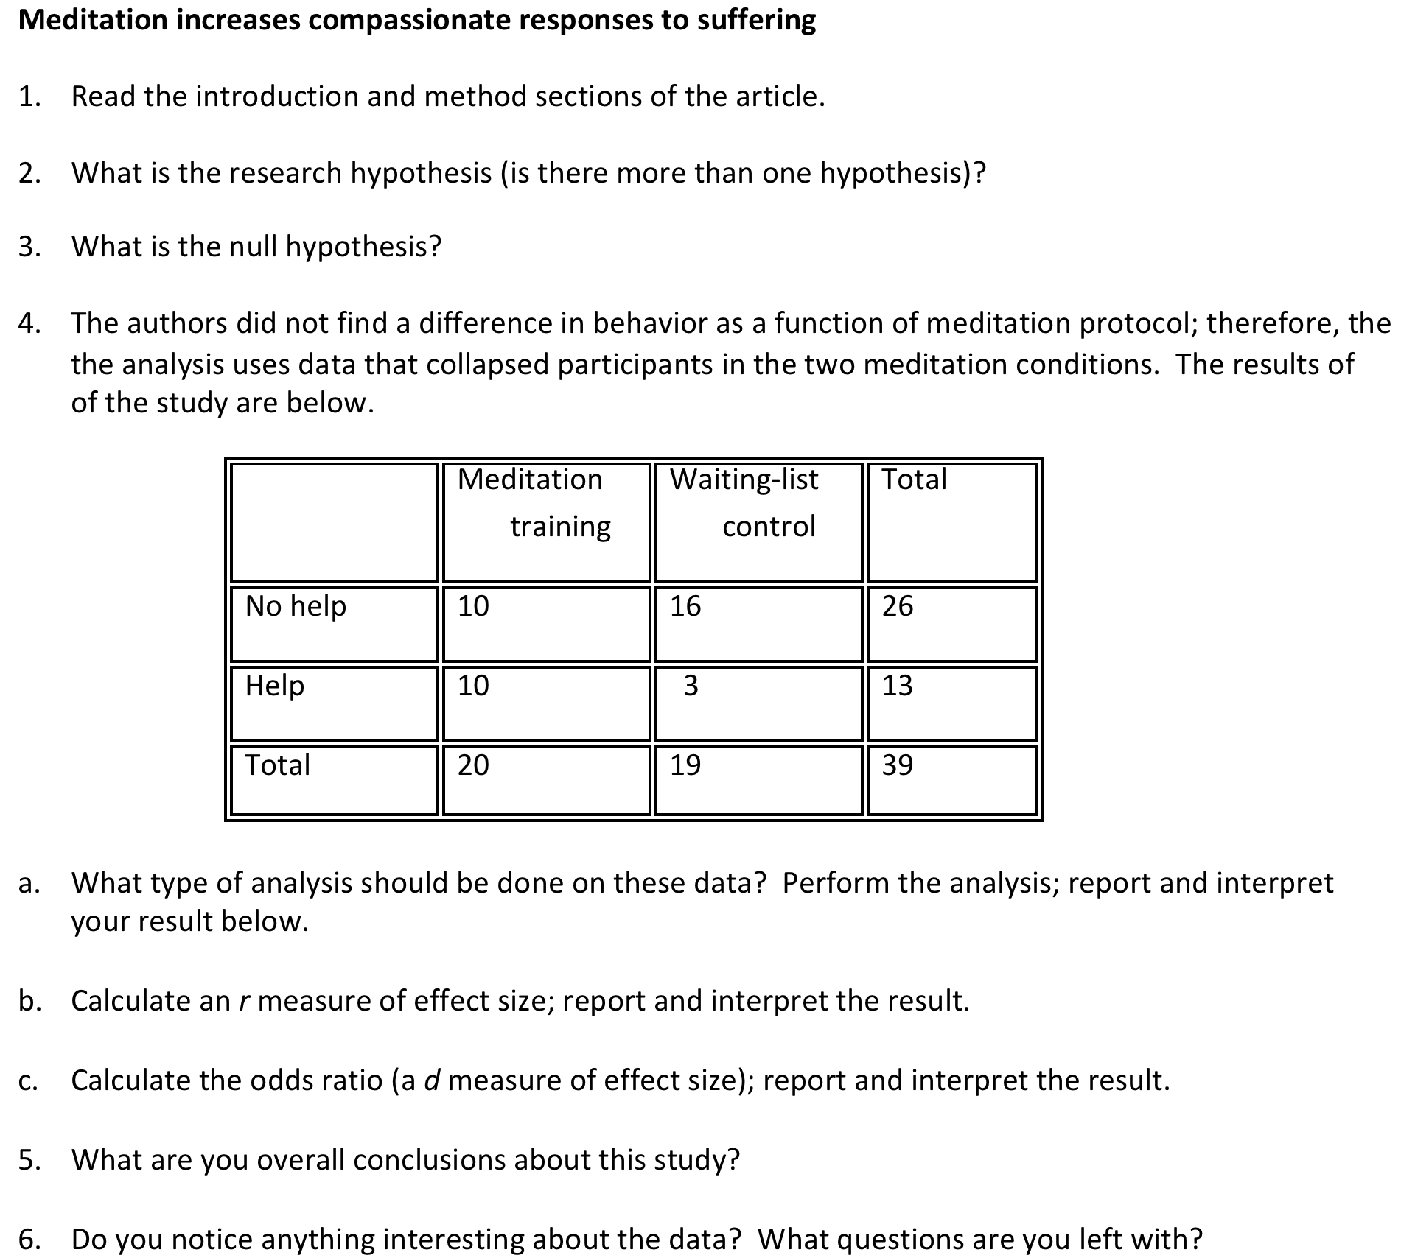

Slide 32
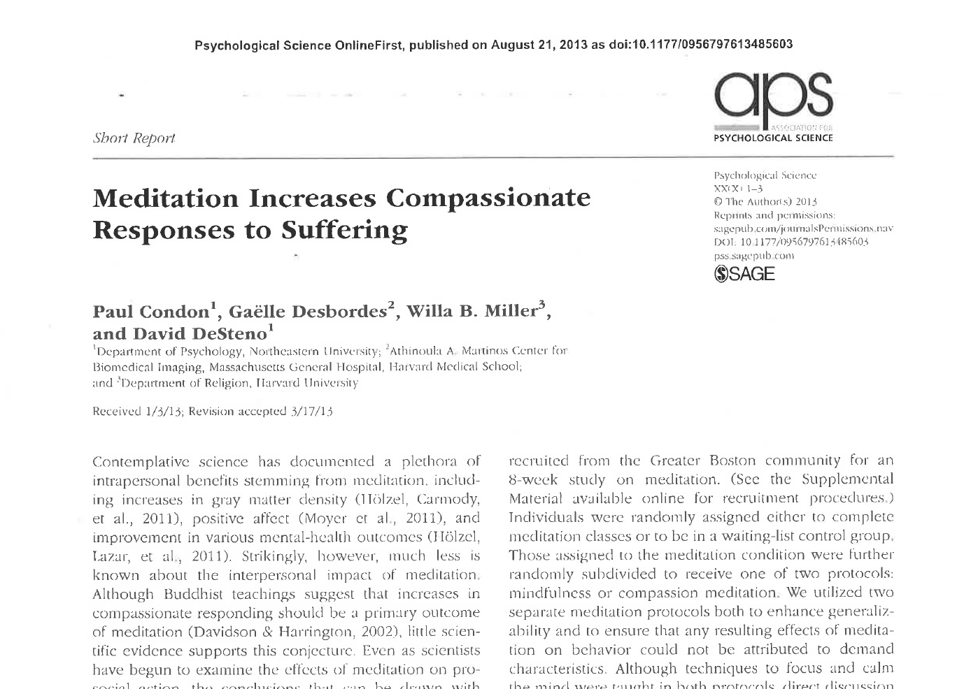

Slide 33
The next example is from a course in earth and ocean sciences (Jones, 2009). The image on the left is the original data graphic provided to teams, and the image on the right is an overlay of the responses from two teams, each using their own color. Teams were required to interpret the data by identifying two linear features with lines and the location of one additional feature with a circle.

Slide 34
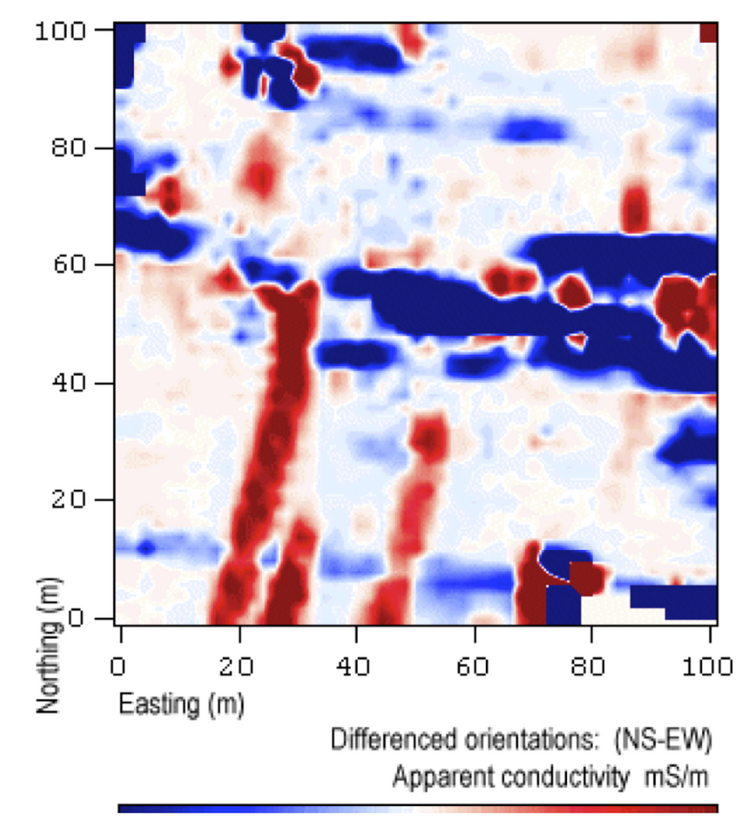
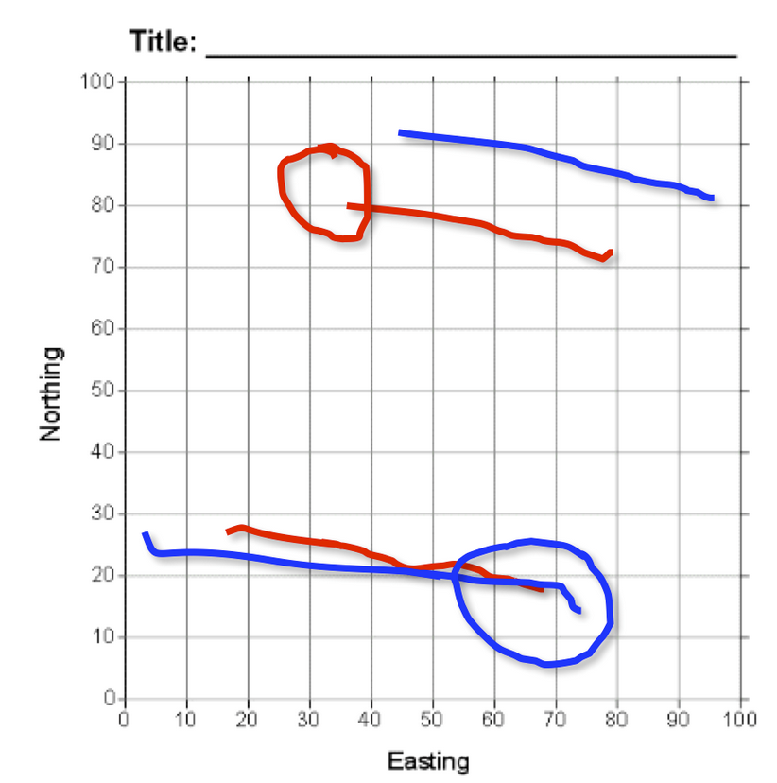
The image on the left is the original data graphic provided to teams, and the image on the right is an overlay of the responses from two teams, each using their own color. Teams were required to interpret the data by identifying two linear features with lines and the location of one additional feature with a circle.
Stacked Overheads
Jones, 2009

Slide 35
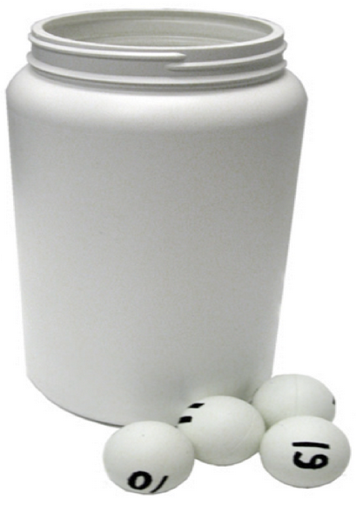
Hot Seat 1

Slide 36
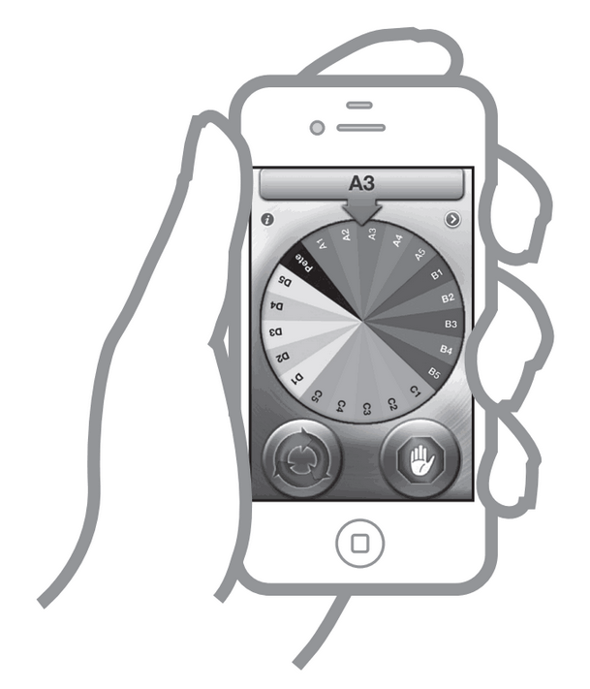
Hot Seat 2
Pick Me or YouSpin for iPhone

Slide 37
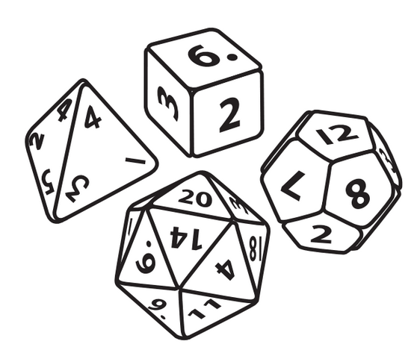
Hot Seat 3

Slide 38
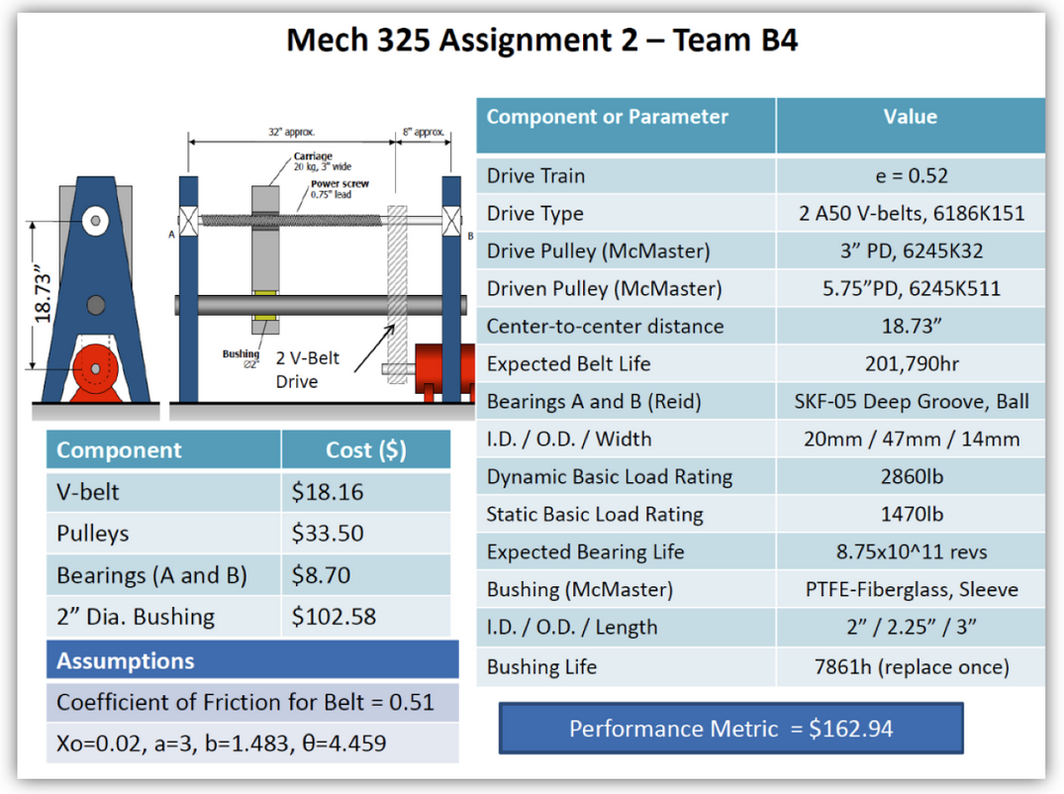
Gallery Walk 1
Teams complete detailed worksheet

Slide 39
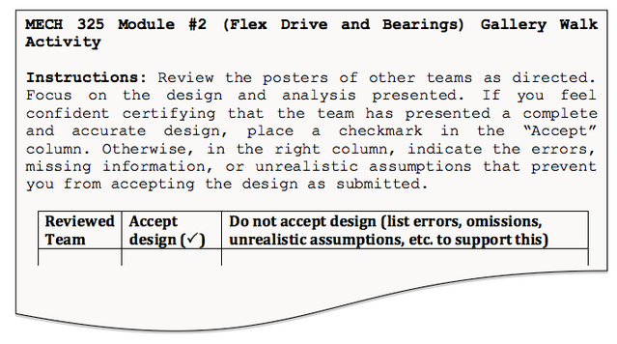
Gallery Walk 2

Slide 40
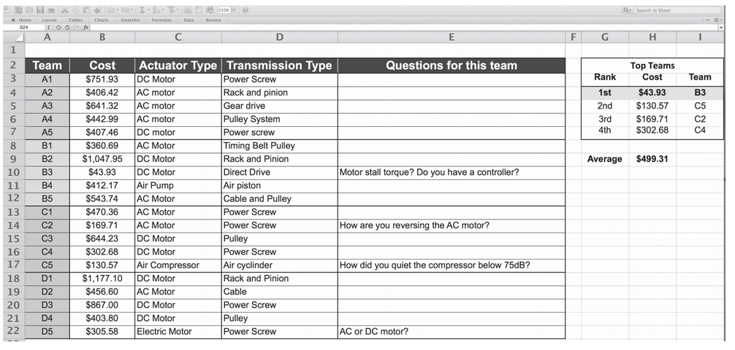
Google Doc and Forms
Student all enter data then instructor displays all results at once

Slide 41
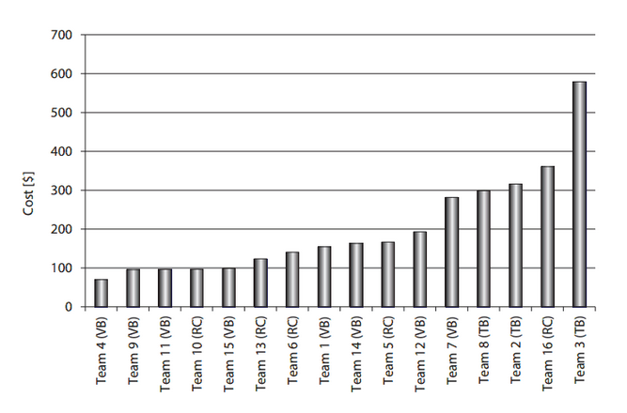
Excel Chart
Enter reported student values then display all at once

Slide 42
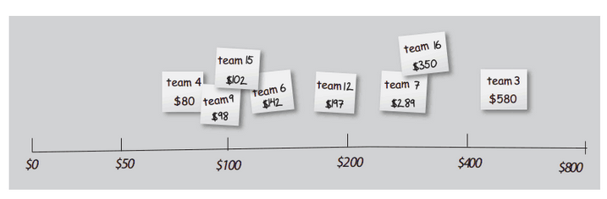
Post-it note: Horse race

Slide 43
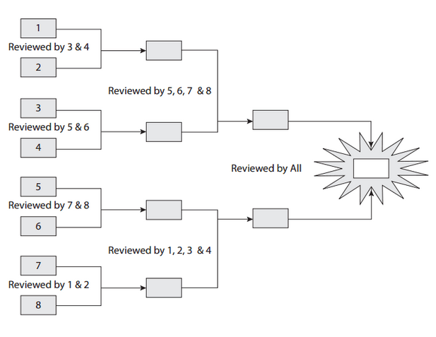
Design Tournament

Slide 44
Facilitation

Slide 45
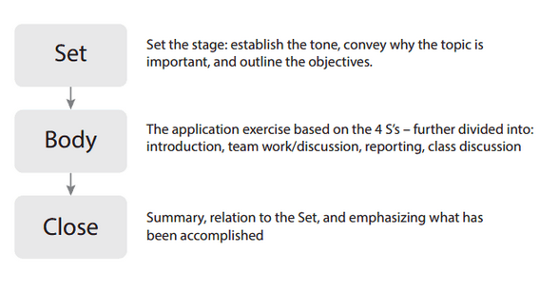
Structure of Application Activities

Slide 46
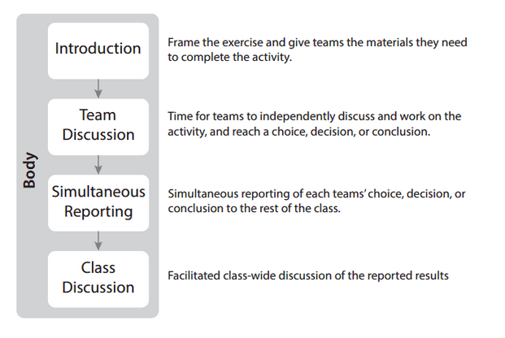
Structure of Application Activities

Slide 47
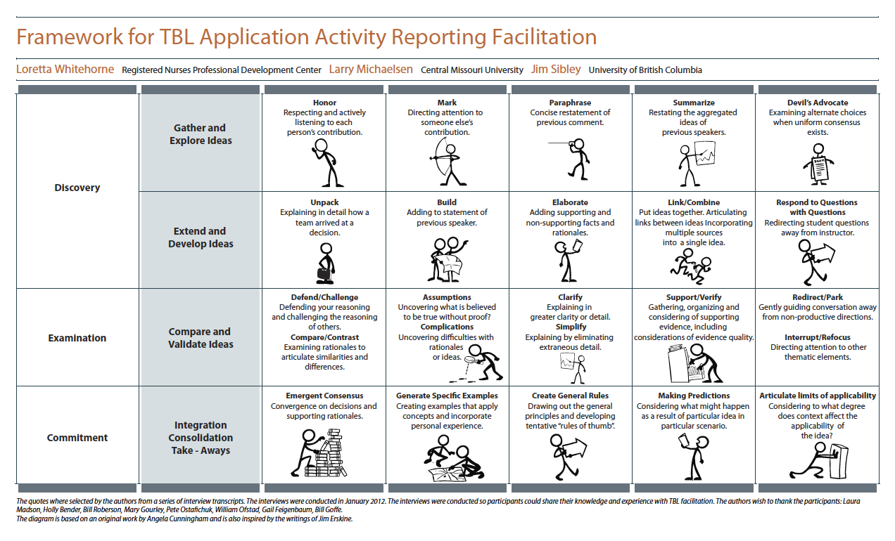

Slide 48
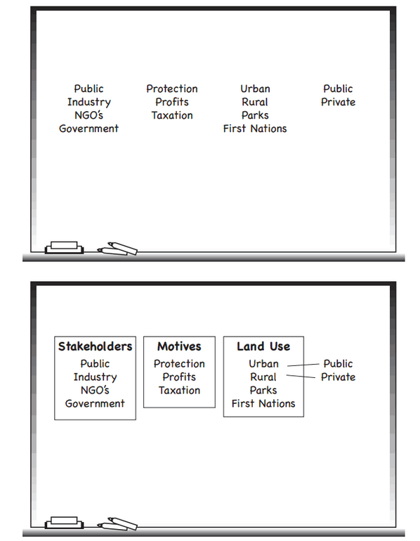
Use pre-planned board plan to
powerfully capture Application Activity
reporting discussion. This can be used for closure.

Slide 49
Large Classes

Slide 50
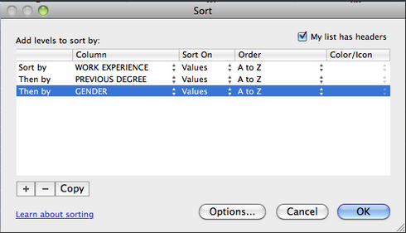
Online
Survey
Download results use Excel to build teams
Post teams and build classroom map
Team formation in large classes – use online survey and build teams from results – using nested sorting in Excel – actually same process as forming a line and counting off, but electronic

Slide 51
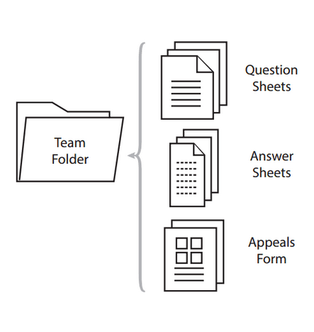
Use Barbara Millis team folders idea in large classes – makes handle of paper much more efficient – we ask each team to send a representative to front of class to collect teams folder

Slide 52
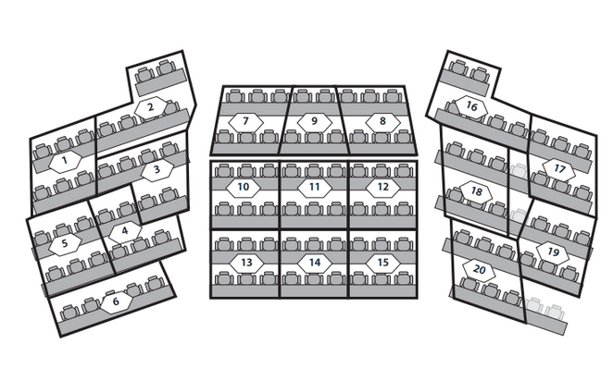
Using classroom map so students know where to find their teammates – team of 6 in a tiered lecture hall gives the best team shape

