Slide 1
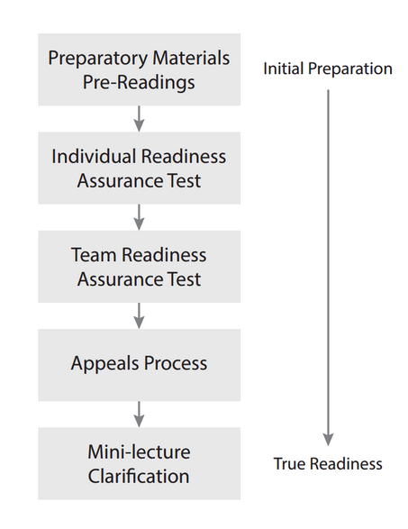

Slide 2


Slide 3
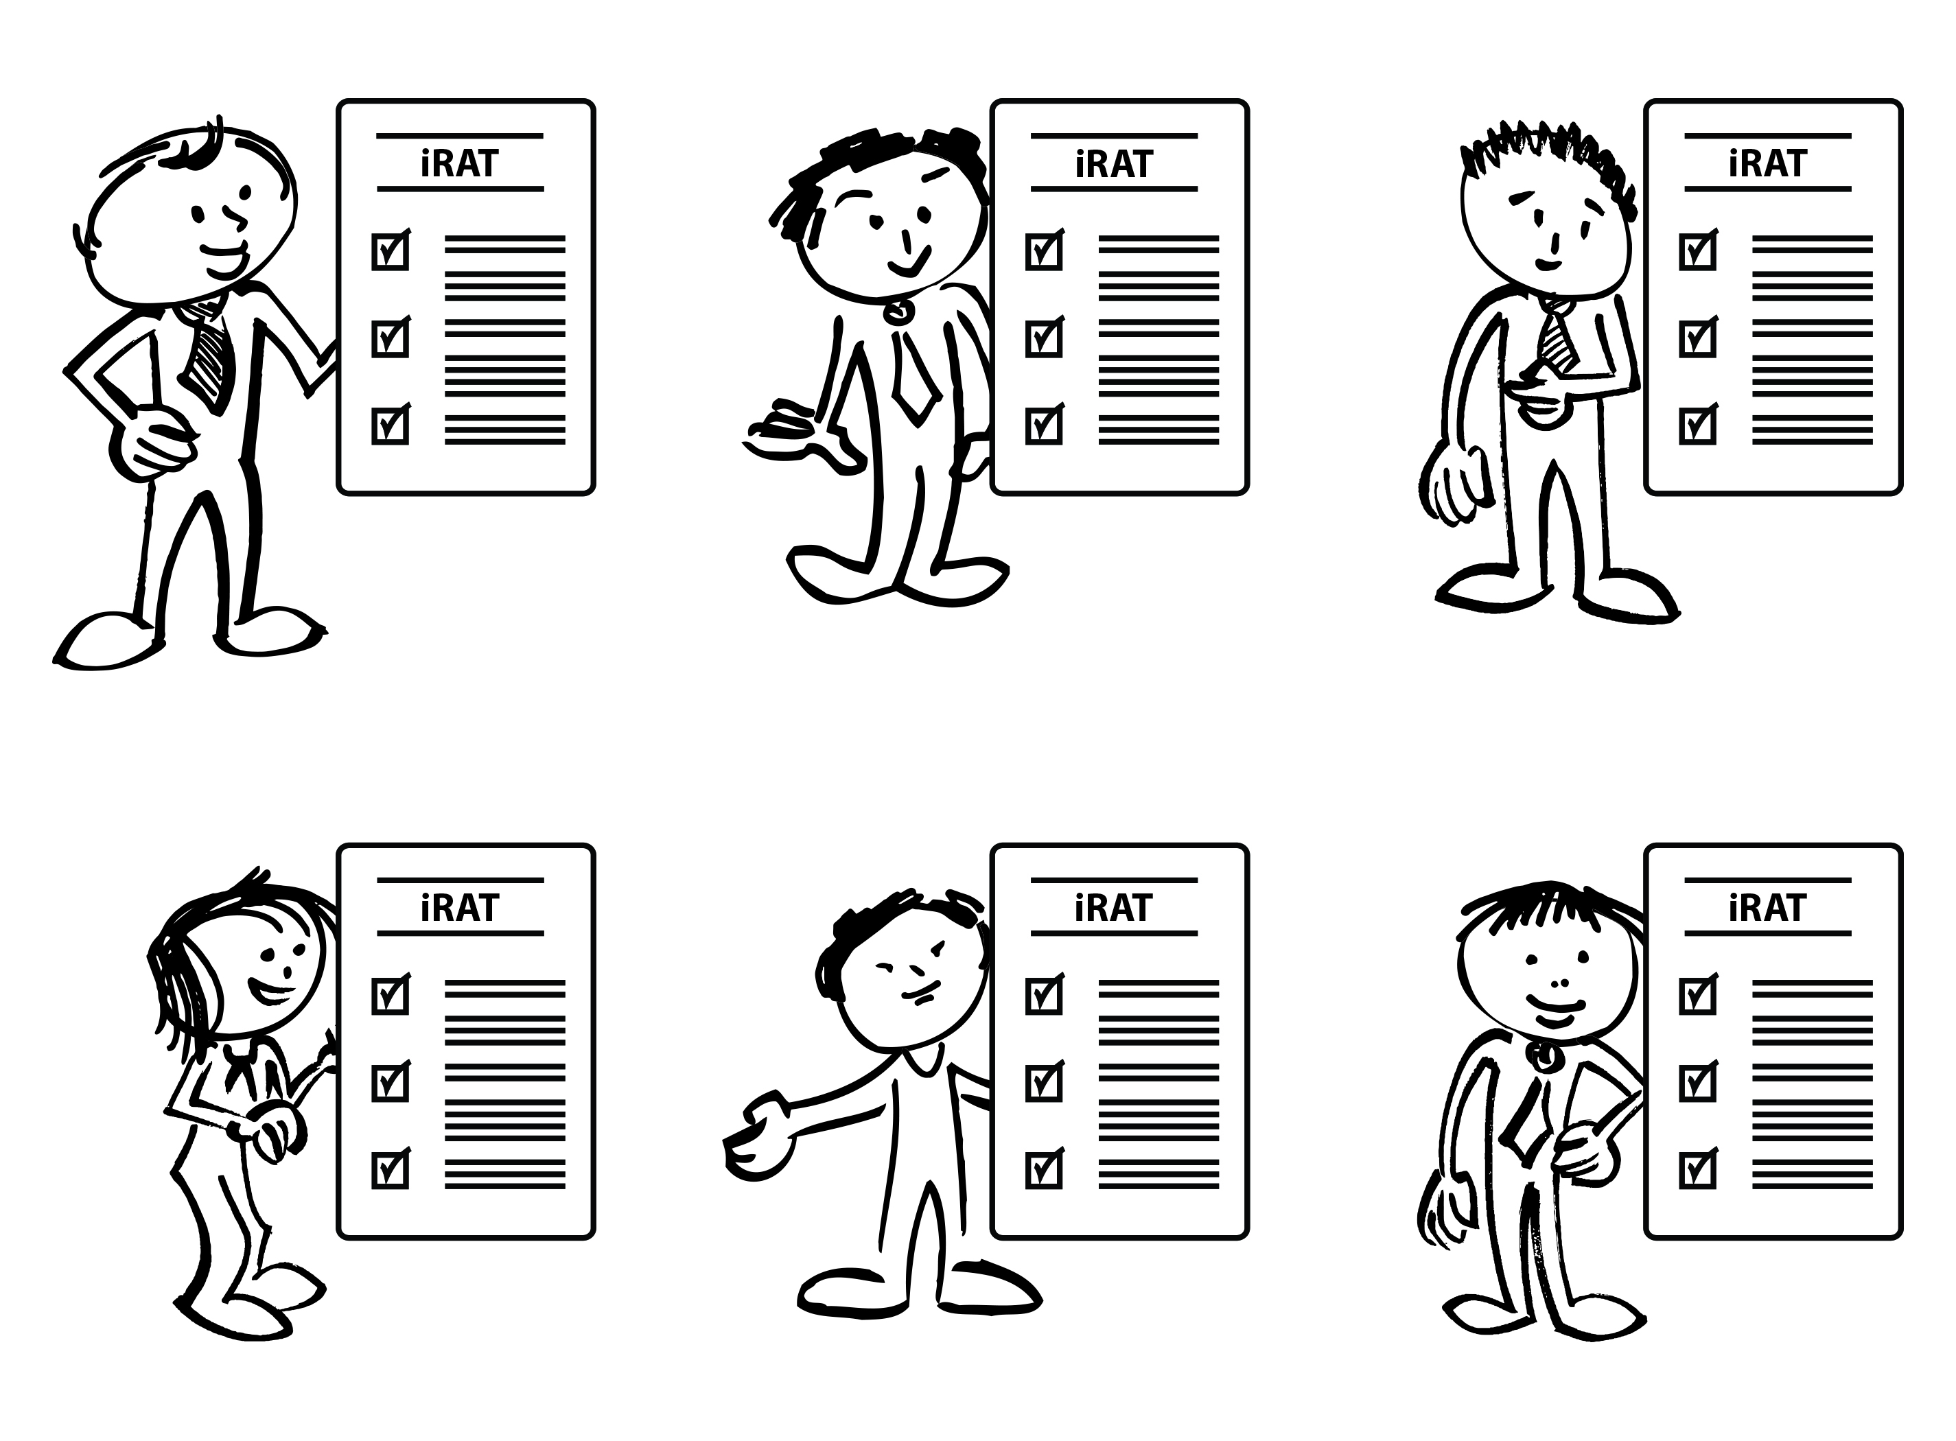

Slide 4
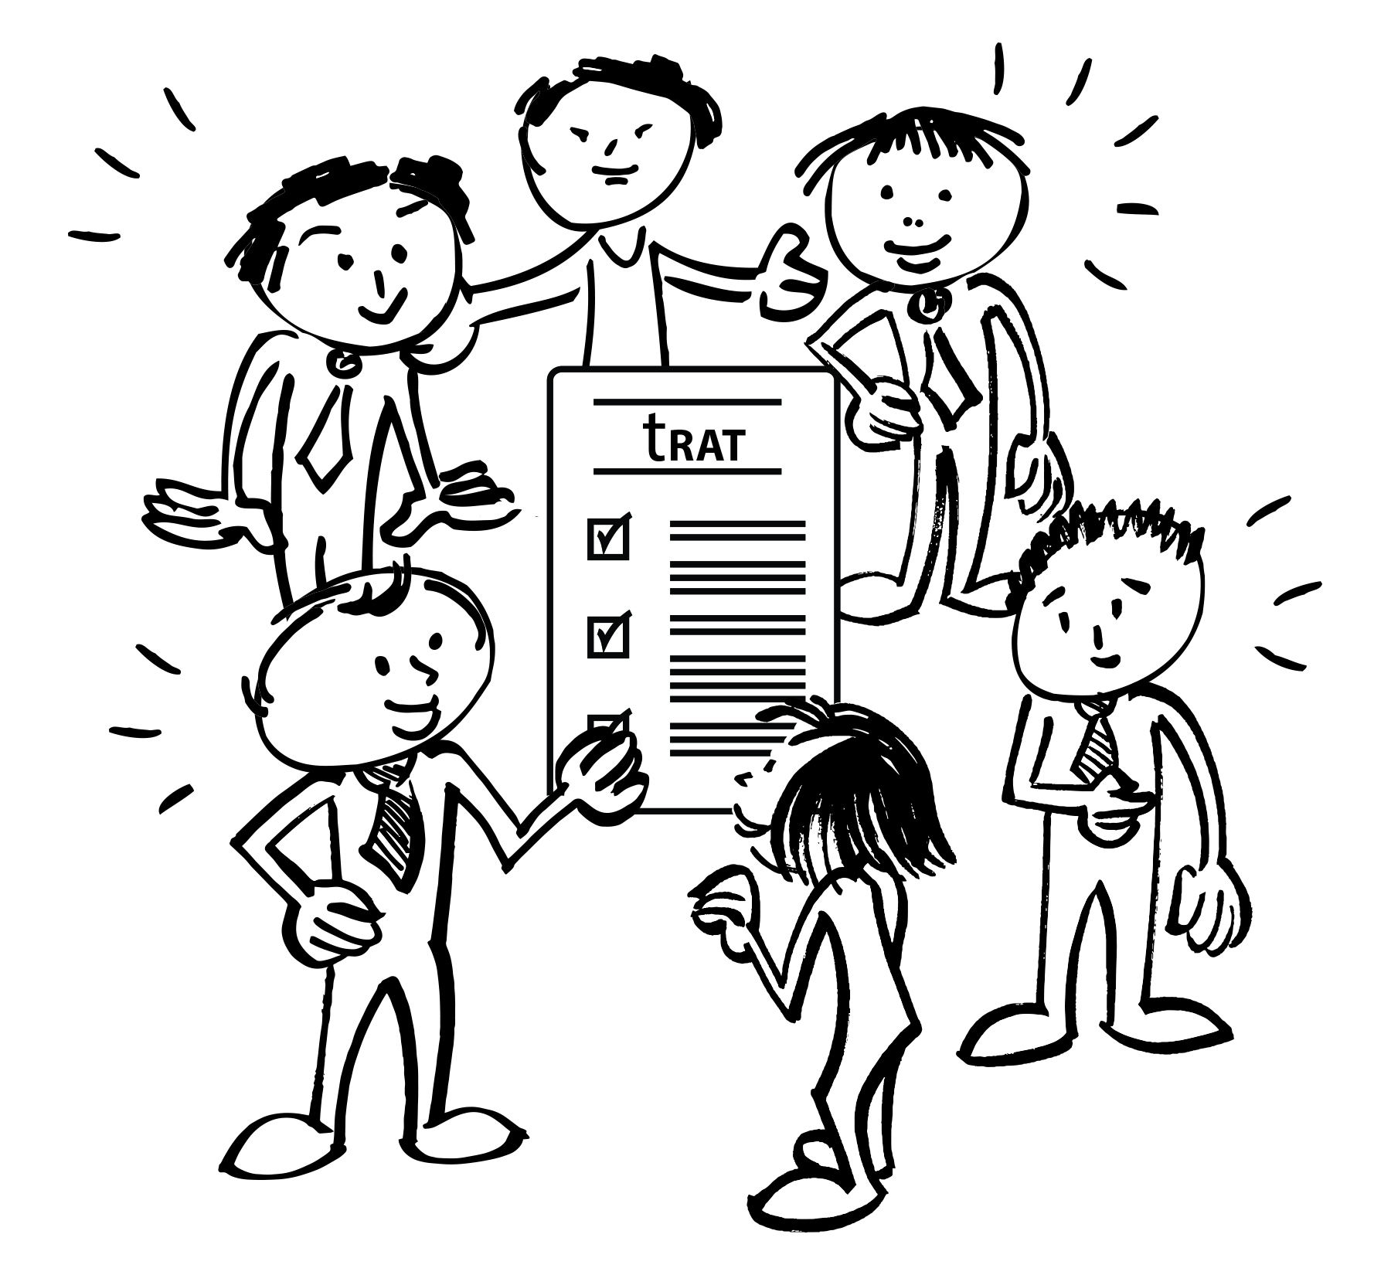

Slide 5
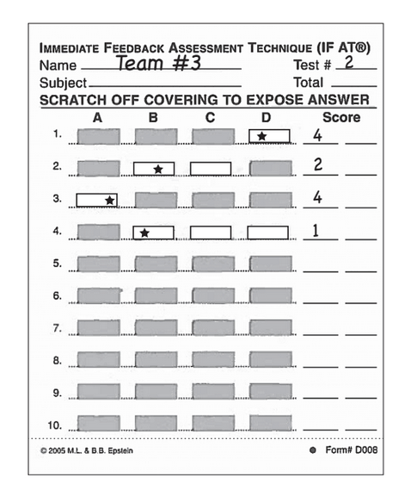
IF-AT’s www.epstienducation.com

Slide 6
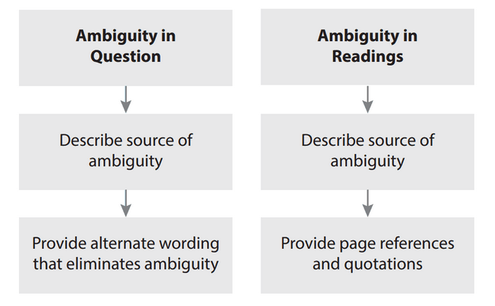
Appeals Process – written scholarly argument, only from teams, and only considered after class – must provide specific evidence – only team that appeals benefits when appeal is accepted

Slide 7
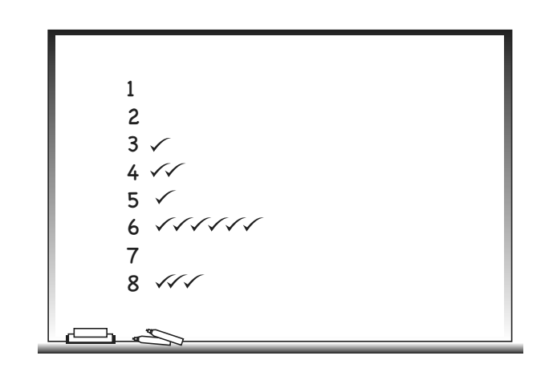

Slide 8
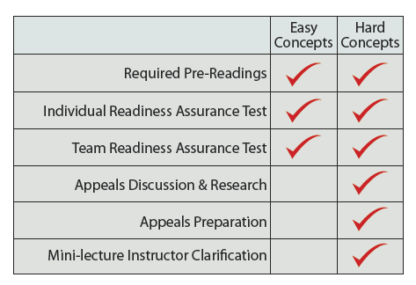
Notes:
Magic of the readiness assurance process
Bob Philpot – South University – “the RAP is about identifying the 10-15% of the content I actually need to talk to students about”

Slide 9
