Slide 1
Building Good Tasks
for Teams

Slide 2
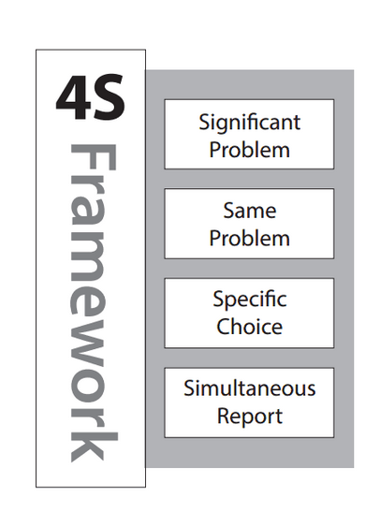
Application Activities

Slide 3
Are they really just multiple-choice questions?
Complex data, complex decisions, simple report

Slide 4
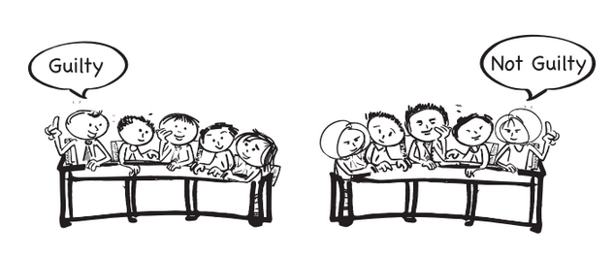
Jury Analogue

Slide 5
Concrete
Example

Slide 6
A patient with a Brain Stem Stroke has collapsed a lung from intractable hiccups and feed-tube aspirates. He was admitted to intensive care to deal with the subsequent pneumonia. A few weeks later he is moved to a regular ward and the PRN order for Baclofen has expired (Baclofen, Gabapentin family of drugs - off label use to control intractable hiccups). The patient has begun to hiccup again and is growing increasingly distressed that nothing is being done. The patient’s wife has repeatedly come to the nurse’s station demanding action. It is Friday night of a long weekend and the doctor on call is not returning the page. The Doctor had made is very clear to the nurses, that he is not to be called. It appears to be a doctor oversight that it was not renewed. The wife persistently demands action and the nurse begins to cry. The head nurse intervenes.
The head nurse should:
  Do nothing, but continue to attempt to contact the doctor
  Give the patient the pill and note it in the chart
  Give the pill, chart it, and continue calling the doctor
  Mark a pill as spoiled and leave it with the patient

Slide 7

Voting Cards

Slide 8
More Examples of
Team Task

Slide 9
A patient come into emergency with the following symptoms... (ADD appropriately COMPLEX SCENARIO HERE)
  What is the first thing you would do? And why?
  B. What is the first test you would order? And why?
  C. What would be the worst thing to do? And why?

Slide 10

Small Whiteboards

Slide 11
You are consulting for a new business owner who wants to open a dry-cleaning store in Norman, Oklahoma. Where would you recommend locating a new dry-cleaning business (and why)?

Slide 12
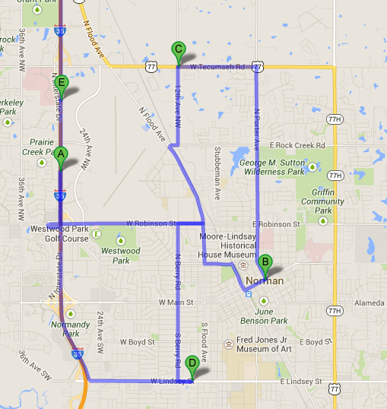
Push Pin in Map

Slide 13
The next example is from a course in earth and ocean sciences (Jones, 2009). The image on the left is the original data graphic provided to teams, and the image on the right is an overlay of the responses from two teams, each using their own color. Teams were required to interpret the data by identifying two linear features with lines and the location of one additional feature with a circle.

Slide 14
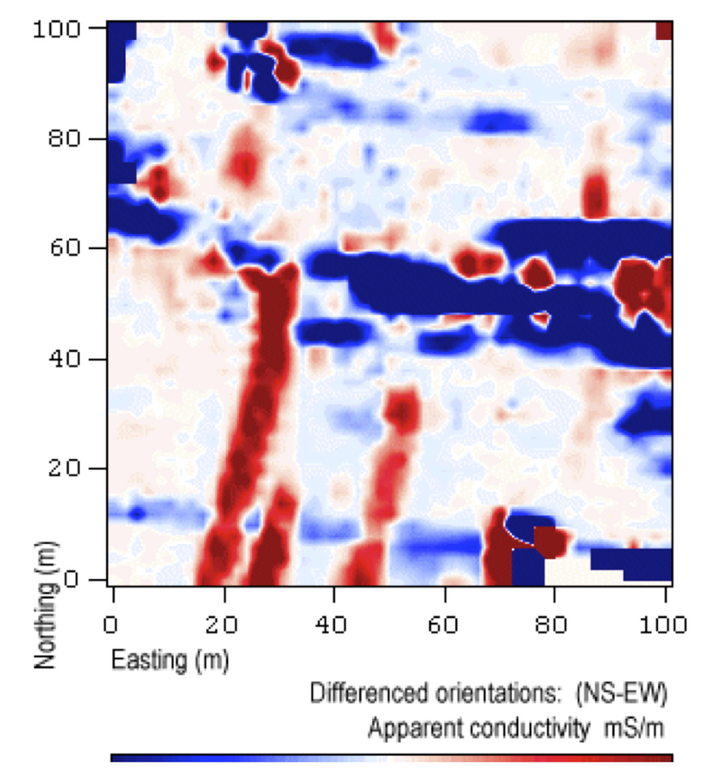
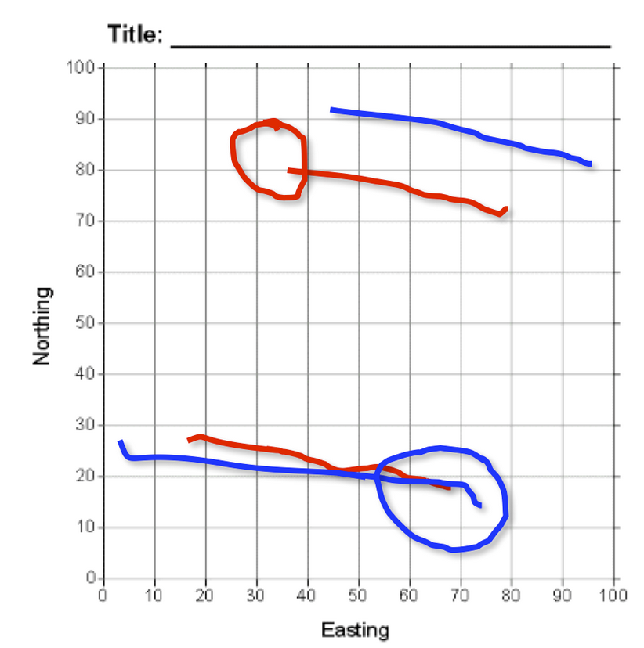
The image on the left is the original data graphic provided to teams, and the image on the right is an overlay of the responses from two teams, each using their own color. Teams were required to interpret the data by identifying two linear features with lines and the location of one additional feature with a circle.
Stacked Overheads
Jones, 2009

Slide 15
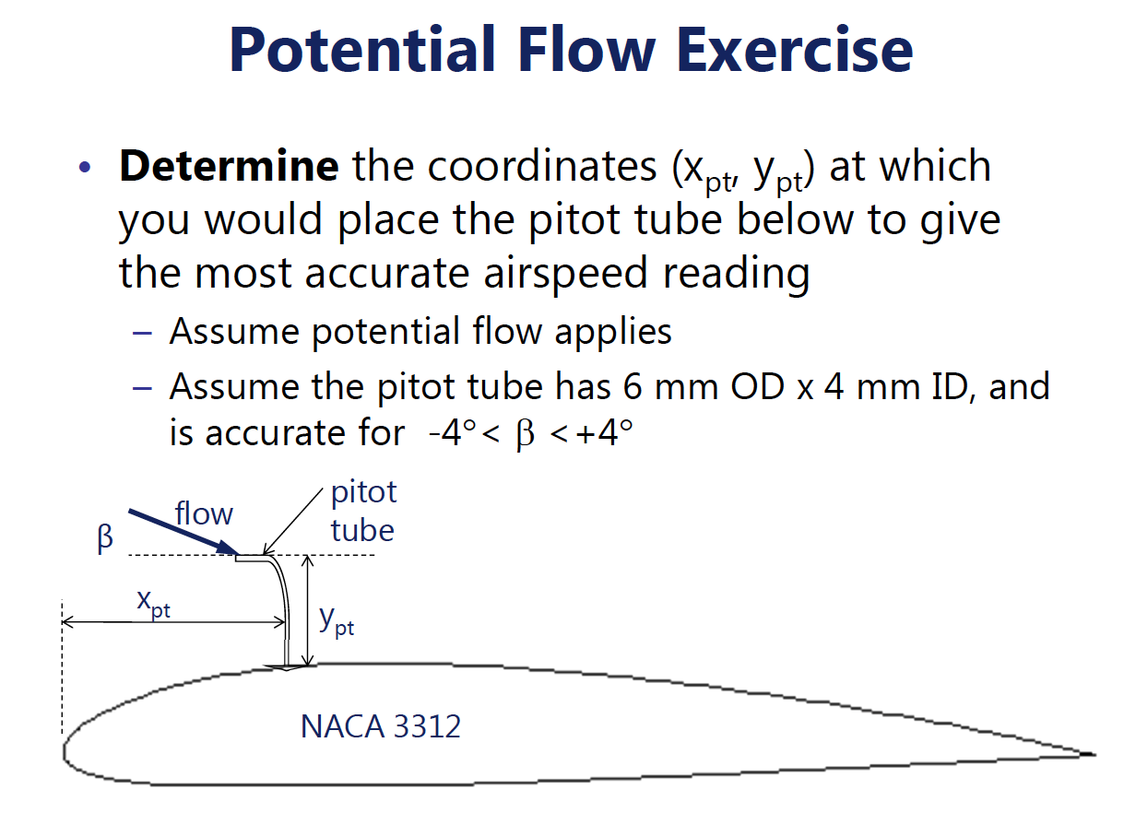

Slide 16
Reporting
Numerical Position
One page summary– principles and approach and not calculations (16 pt font or bigger)

Slide 17
Construction rules for
Team Task

Slide 18
Knowledge from READING
Observation of new situation
Analysis of situation
Judgment
Specific Claim
From Bill Roberson

Slide 19
A patient with a Brain Stem Stroke has collapsed a lung from intractable hiccups and feed-tube aspirates. He was admitted to intensive care to deal with the subsequent pneumonia. A few weeks later he is moved to a regular ward and the PRN order for Baclofen has expired (Baclofen, Gabapentin family of drugs - off label use to control intractable hiccups). The patient has begun to hiccup again and is growing increasingly distressed that nothing is being done. The patient’s wife has repeatedly come to the nurse’s station demanding action. It is Friday night of a long weekend and the doctor on call is not returning the page. The Doctor had made is very clear to the nurses, that he is not to be called. It appears to be a doctor oversight that it was not renewed. The wife persistently demands action and the nurse begins to cry. The head nurse intervenes.
The head nurse should:
  Do nothing, but continue to attempt to contact the doctor
  Give the patient the pill and note it in the chart
  Give the pill, chart it, and continue calling the doctor
  Mark a pill as spoiled and leave it with the patient

Slide 20
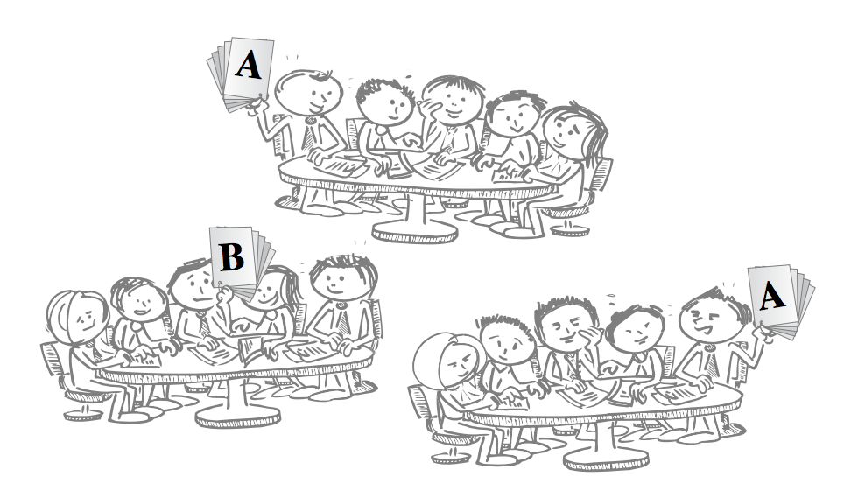
Decisions give visible form to students thinking and use of knowledge
Text from Bill Roberson

Slide 21
3 Step Writing Process
  Identify Typical Disciplinary Thinking Challenge
  Identify Key Concepts and Principles students must be thinking about and using
  Write a Scenario where students are asked to Analyse a situation, make a Judgment and commit to a Decision
From Bill Roberson

Slide 22
Your chance to create Team Tasks

Slide 23
Writing Prompt Three
Select thing
(as best, worst, most, least from a limited set of options)

Slide 24
A few words about
Facilitation

Slide 25
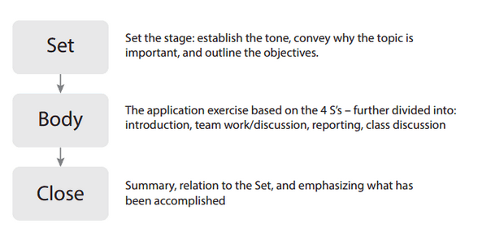
Structure of Application Activities

Slide 26
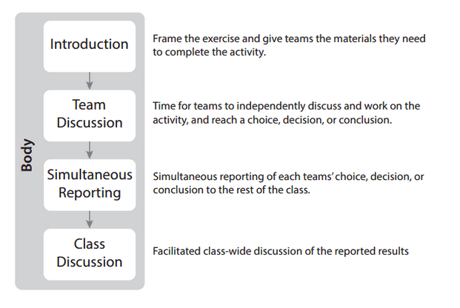
Structure of Application Activities

Slide 27
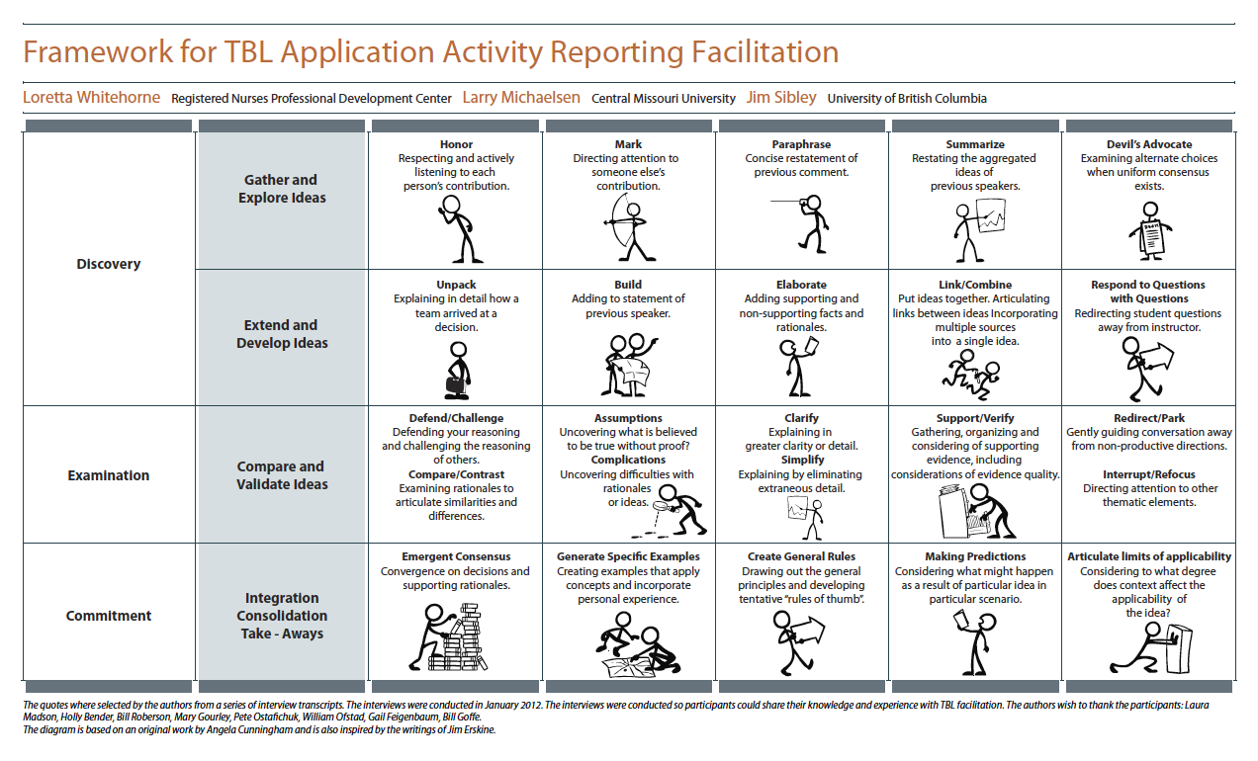

Slide 28
Last Words

