Slide 1
Using Constrained Choice to Intensify Student Discussion

Slide 2
What makes a classroom activity/discussion great?
Notes:
Energy, everyone engaged, depth of conversation, taking work seriously, students looking things up, explaining to each other, making important insights, connections

Slide 3
Energy
Excitement
Engagement
Explaining to each other
Looking stuff up
Making connections
Having insights
Task Focused
Content Focused

Slide 4
Notes:
Read page 1

Slide 5
What would you do in this situation?
What would you do first in this situation?
Which of these would you do first in this situation? (And Why?)

Slide 6
What would you do in this situation?
What would you do first in this situation?
Which of these would you do first in this situation?
Constraint is what intensifies discourse

Slide 7
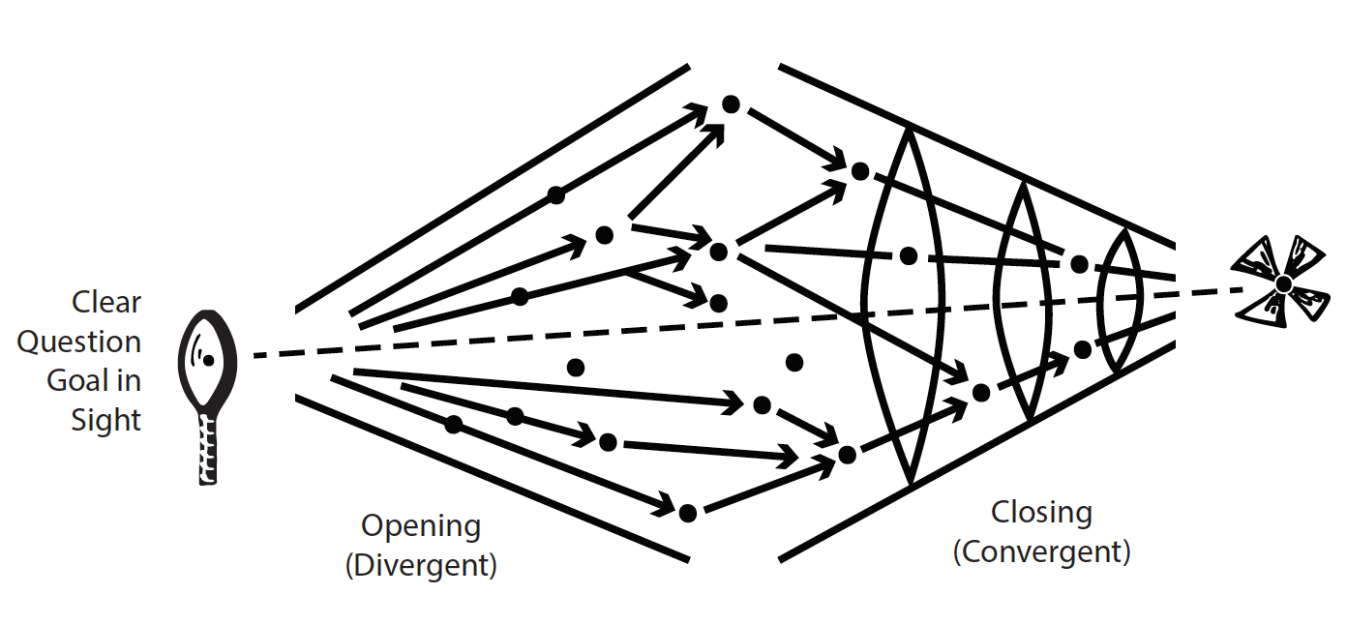

Slide 8
Read Page 2
Notes:
Read page 2

Slide 9
A specific, concrete decision that requires judgment is essential!
Evaluating/Scoring/Ranking
Assessing/Diagnosing
Predicting
Recommending

Slide 10
Think of a specific concrete decision
Create a story that brings students to decision point

Slide 11
Create a story about a situation that brings students to a decision point
You go into a supermarket and see 8 brands of cheese…
Here’s a picture of a client who just walked into your hair salon…
Here are 3 letters by applicants for director of…
Here’s an article on the defunding of education from newspaper x…
Here’s a description of the assassination of Henry IV…
Here are 3 paragraphs about X by 3 different authors…
Here’s a new product that needs testing…

Slide 12
Write a prompt as a DECISION or CHOICE needed in response to a situation - that naturally elicit why this and not that?
Which of the options presented is best/worst?
What would you do first/last?
Which of these items will be most/least effective?
What is the most likely outcome/consequence?
How would you rank these?
What score would you give this?

Slide 13
Read Page 3-4
Pick a prompt type to work from
Follow steps from page 2

Slide 14
Concrete situation description
Question
Prompt
Something to analyze – to understand more about situation
Stories, images, evidence, articles, charts, data sets, test results, text passages
A decision to be made - question with a superlative so teams are forced to make a decision and pick one option - rank, score, sort, best, worst, cheapest, most efficient, first, last, etc.
A. One possible, plausible, competitive course of action/decision
Possible decisions
B. Another possible, plausible, competitive course of action/decision
C. Another possible, plausible, competitive course of action/decision
D. Another possible, plausible, competitive course of action/decision
Template to organize your work

Slide 15
Table Sharing/Feedback

Slide 16

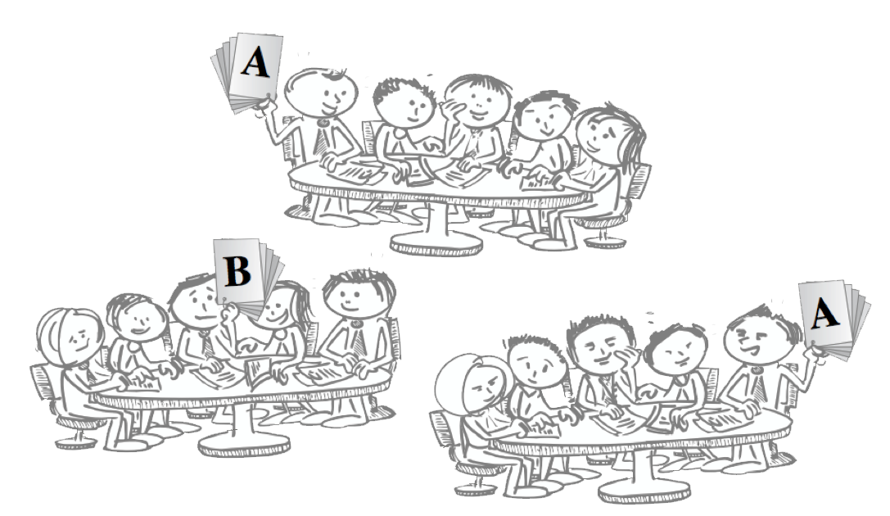
Notes:
Public report of decisions give visible form to students thinking and application of knowledge. Allows everyone to compare thinking. Powerful discussion primer when differences are made visible.

Slide 17
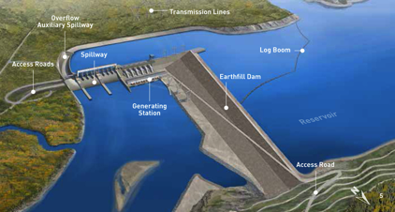
You are head of Engineering for a large dam project on the Yellow river in the Ningxai province of China. The dam is to be located in the Yiling district near the exit of the Ordos Loop section of the river. The dam is to be located at 34°49′46″N 111°20′41″E. The Yellow river is China’s third largest river. The river is characterized by extremely high silt loads, especially in spring floods. The local bedrock is highly fractured gneiss. The dam will be a concrete earthfill hybrid design. You have been asked to determine some of the main design parameters, including safety related questions like what flood event return period to build the dam to withstand.
What flood return period would you recommend the dam be designed to withstand?
once in 50 year flood
once in 100 year flood
once in 200 year flood
once in 500 year flood

Slide 18
A patient come into emergency with the following symptoms... …add appropriately COMPLEX SCENARIO and DATA here
Possible 4S: What is the first thing you would do? And why?
  Possible 4S: What is the first test you would order? And why
  Possible 4S: What would be the worst thing to do? And why?

Slide 19
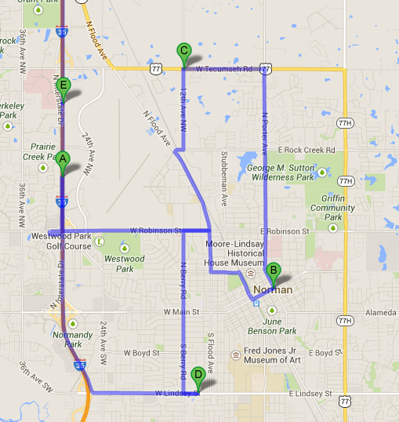
You are consulting for a new business owner who wants to open a dry-cleaning store in Norman, Oklahoma.
Where would you recommend locating a new dry-cleaning business (and why)?
Push Pin in Map

Slide 20
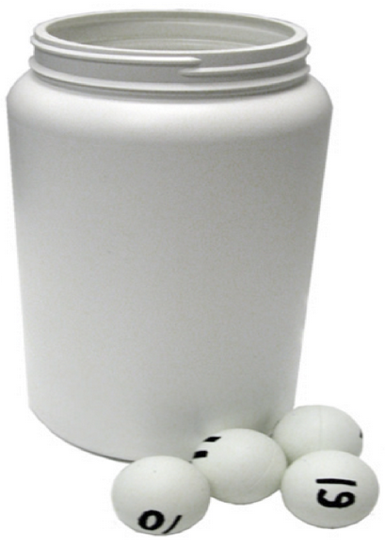
Hot Seat

Slide 21
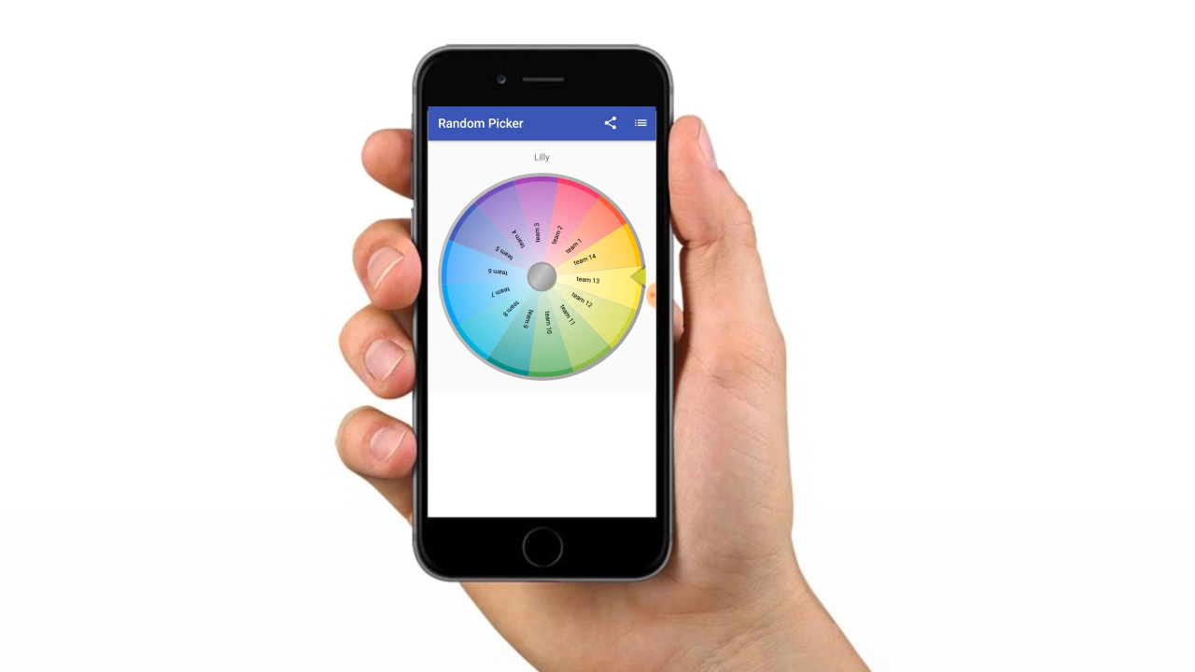
The Wheel of Motivation
Notes:
Team 5

Slide 22
Instructor enters numerical positions then displays all at once
One page summary– principles and approach and not calculations (16 point font or bigger)
Excel Charts

Slide 23
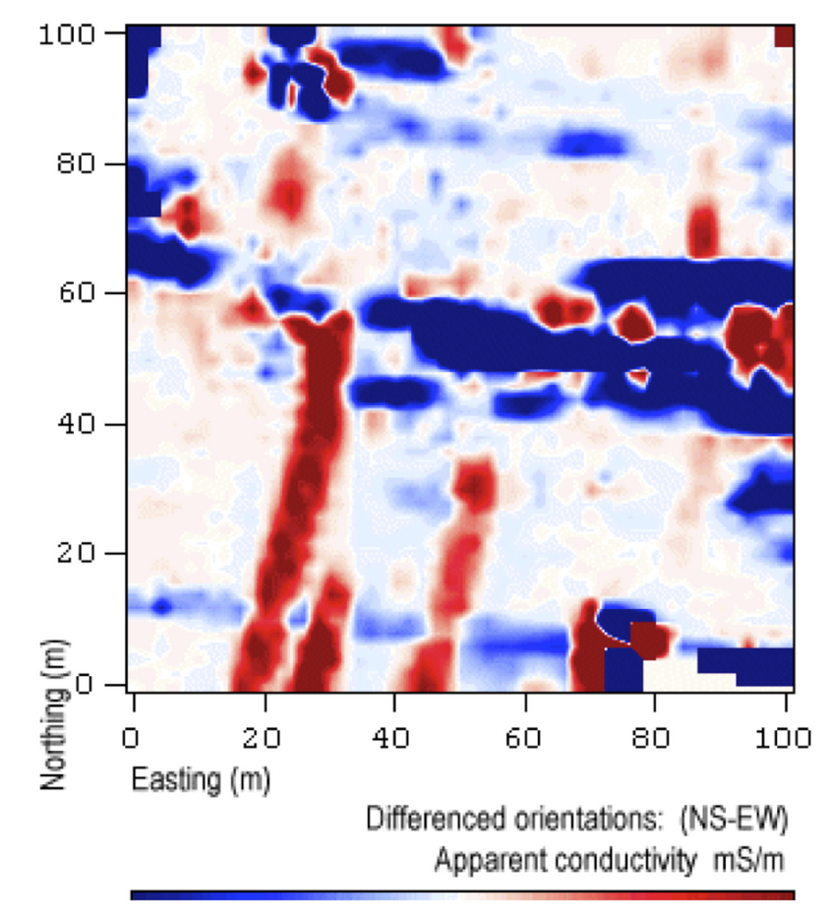
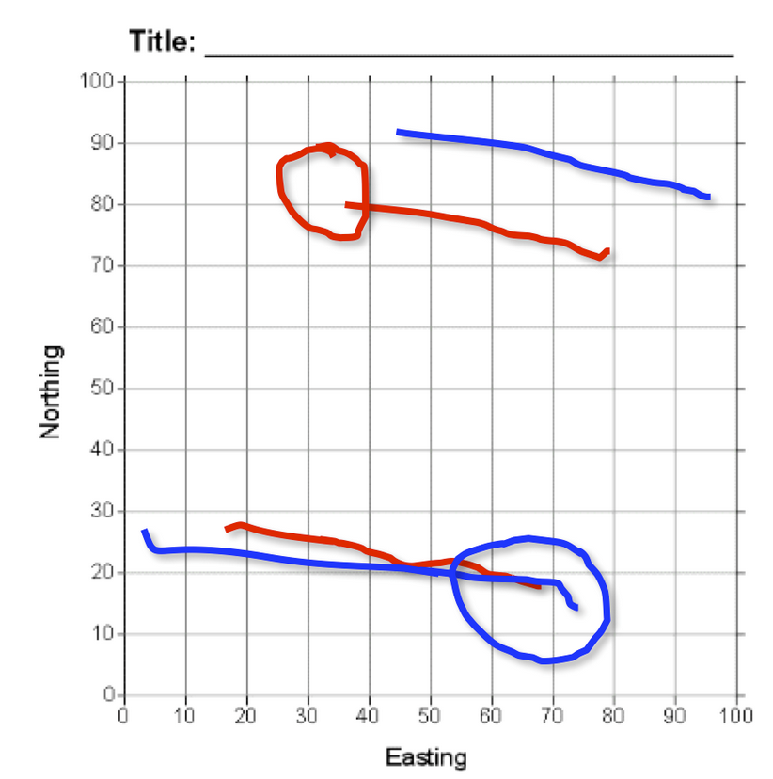
The image on the left is the original data graphic provided to teams, and the image on the right is an overlay of the responses from two teams, each using their own color. Teams were required to interpret the data by identifying two linear features with lines and the location of one additional feature with a circle.
Stacked Overheads
Jones, 2009

Slide 24
Facilitation for breadth at beginning and more depth as discussion develops.
* Important to have a plan to ensure that important take-aways emerge from reporting discussion (you might need to gentle facilitate this).

Slide 25
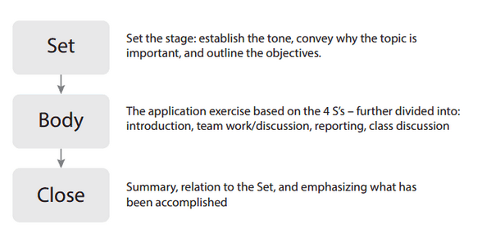

Slide 26
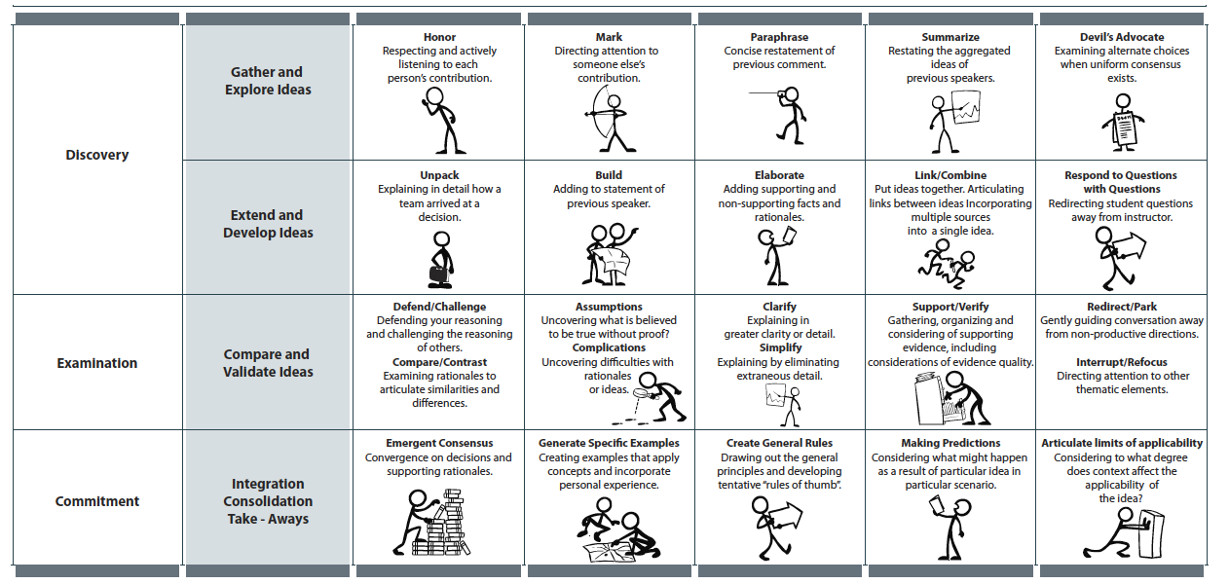
The design of a task is ultimately only as good as its execution and management
Roberson and Franchini
learntbl.ca/how-to-facilitate‎

Slide 27

Where to learn more about Team-Based Learning and 4S problems
learntbl.ca

Slide 28
Questions
jim.sibley@ubc.ca

