Slide 1
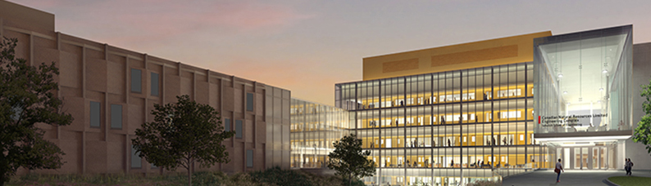
Teaching, Learning and Course Design
Jim Sibley
Director – Centre for Instructional Support
University of British Columbia
February 19, 2019

Slide 2
Teaching, Learning and Course Design
9:00 – 10:25 Building a Solid Foundation
10:25-10:35 Break
10:35 - 12:00 Design Better Classes
12:00 - 1:00 Lunch
1:00 – 2:25 A method to consider - Team-Based Learning
2:25-2:35 Break
2:35 – 4:00 Building Great Classroom Activities

Slide 3
Building a Solid Foundation
Jim Sibley
Director – Centre for Instructional Support
University of British Columbia
February 19, 2019

Slide 4
If you don’t know where you are going? How will you know when you get there?
Steven Covey

Slide 5
Learning Outcomes
Can describe why Backwards Design is important
Can identify the 3 components of the Fink Triad
Can identify the Bloom’s level of a learning outcome
Can write a simple learning outcome

Slide 6
Backward design is the reccomended method of designing instruction by first setting goals before choosing instructional methods and forms of assessment.
Notes:
Start with the end in mind

Slide 7
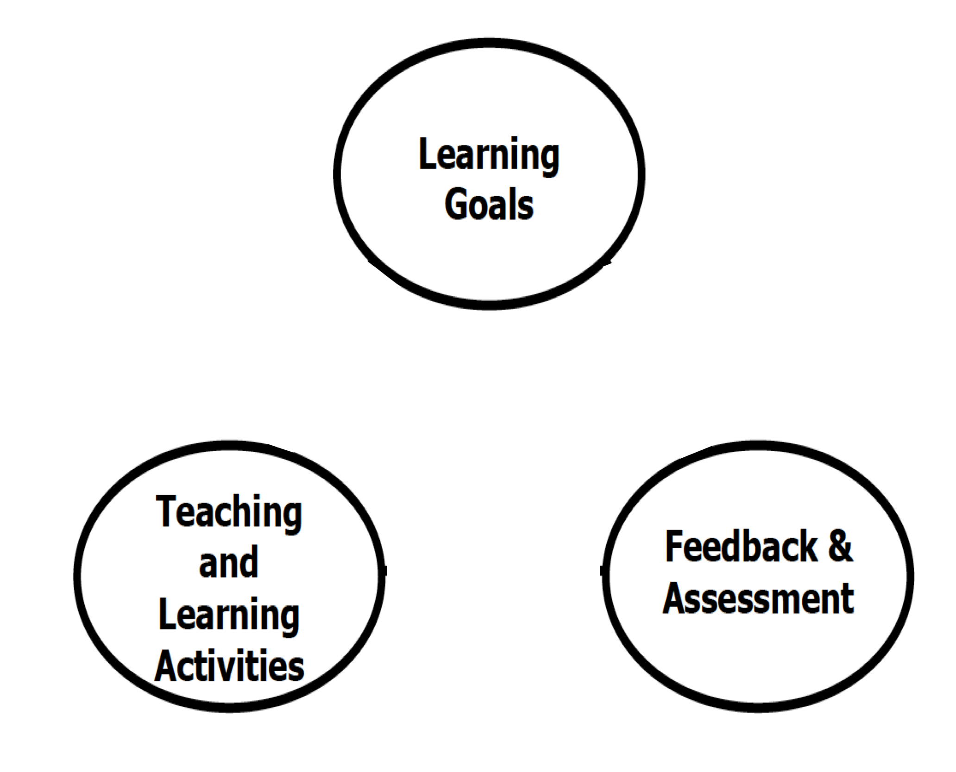

Slide 8
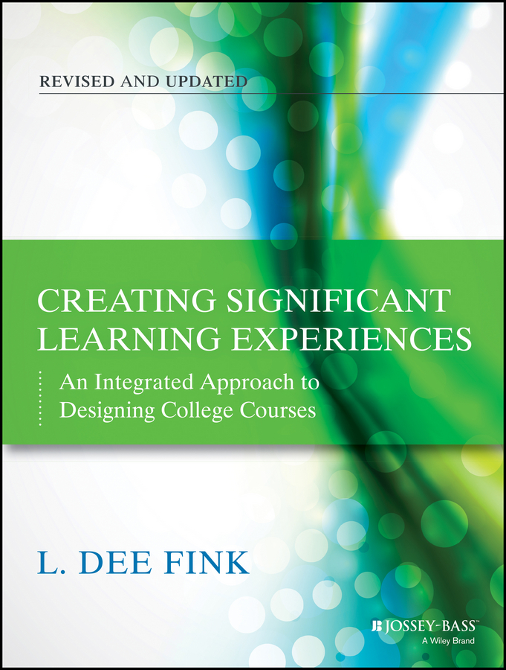
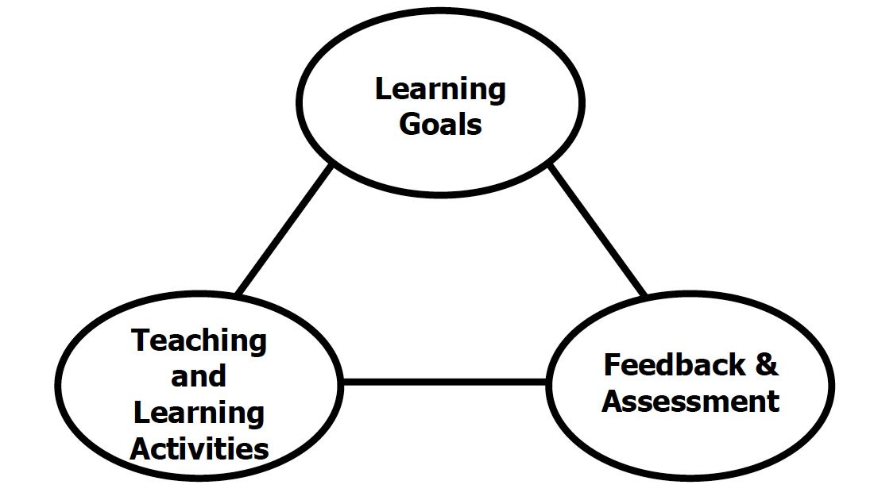
Fink Triad

Slide 9
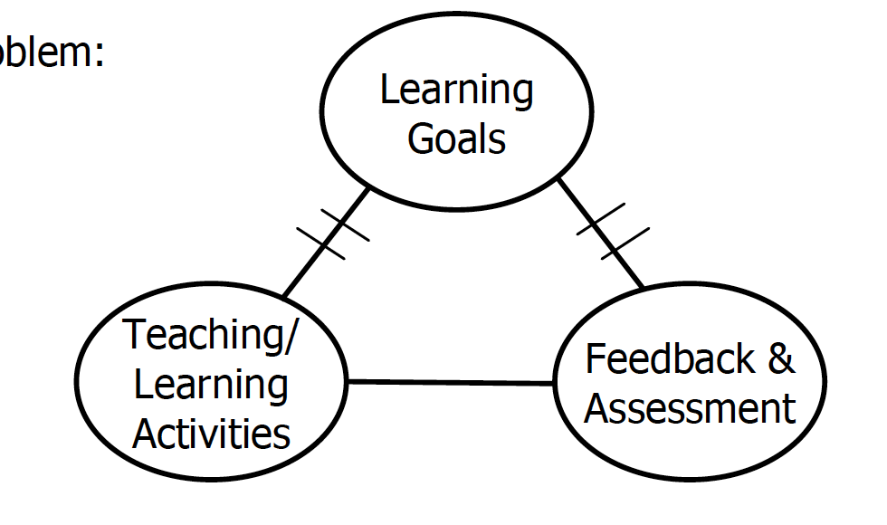
Notes:
Most commonly lectures, note taking, cramming, exams of can you remember – Goals of higher level like application and synthesis

Slide 10
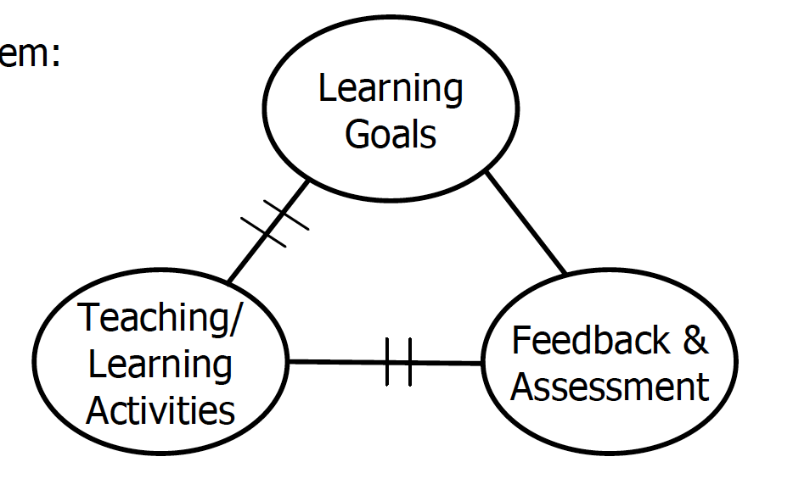
Notes:
Lofty goals – TL activity at lower levels – lecture/remember – examines high Bloom’s levels that student are not prepared for – recount Physics exam experience

Slide 11
Outcomes
Fink Triad

Slide 12
Learning outcomes are statements that describe significant and essential
learning that learners have achieved, and can reliably demonstrate at the end of a course of instruction

Slide 13
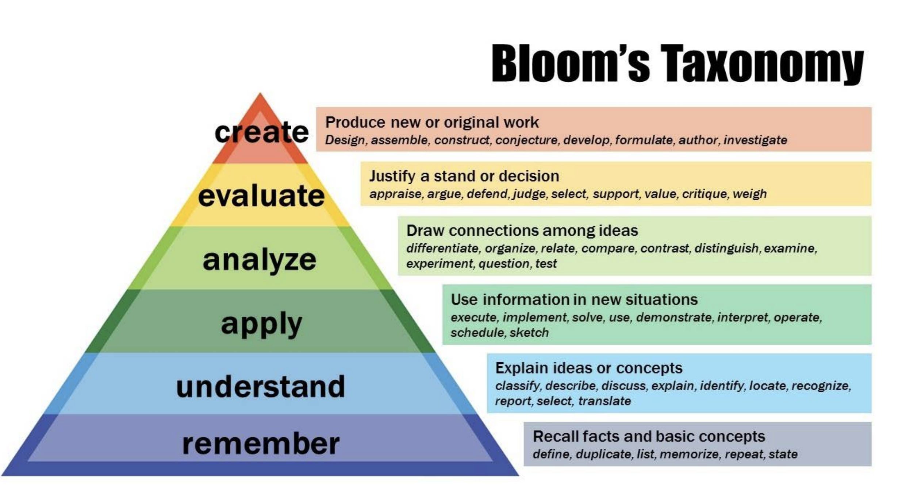
CAUTION!!
Notes:
Tell Bloom’s taxonomy creation story – other domain’s – I feel in love – was blind only saw Cognitive Domain- need to apply while you are learning the facts – A Time for Telling

Slide 14
Learning outcomes at a very simple level are created by attaching a Bloom’s verb to a piece of content
  Define + flood return period
  Apply + flood return period

Slide 15
Identify Bloom’s level Activity
Lists steps in preparing a bar chart.
Distinguishes among terms that are similar in meaning.
Writes a set of learning outcomes.
Describes how the process functions in a given situation.
Defines a concept.
Evaluates report using specific criteria.
Knows meaning of specific terms.
Demonstrates proper technique.
Predicts the outcome in a given situation.
Use Bloom’s verb table

Slide 16
ABCD Learning Outcomes Model
(comprehensive model – may be a little too comprehensive!)
A very complete learning outcome has 4 parts
A - Audience
B – Behaviour (Bloom’s verb)
C - Conditions
D - Degree

Slide 17
Students will be able to construct a working model in less then 30 minutes
Audience = students
Behaviour = construct
Conditions = 30 minutes
Degree = working

Slide 18
Why do well constructed Learning Outcomes matter?
In Groups – brainstorm a list of reason to build GOOD Learning Outcome's

Slide 19
Clarity for teacher and student on where they are going together
Helps teacher select appropriate teaching and learning activities
Helps student know what to focus on for studying and test prep
Helps teacher construct assessment that are thorough and fair
Accreditors love/demand them
Gives a common currency to examine links between courses and integration into program level outcomes

Slide 20
Step 1:
Start with a simple rather inert feeling Learning Outcome
Making a Learning Outcome Vibrant
Define Flood Return Period
Notes:
Giving LO’s life

Slide 21
Step 2:
Pick a new verb to increase
Bloom’s level and make it active
Explain Flood Return Period

Slide 22
Step 3:
Add a concrete situation that requires a judgment
Students will predict the outcome
of this situation WRT flood return period

Slide 23
Step 4:
Bring students to a specific decision point
Students will predict the most likely
outcome of this specific situation
Notes:
Note: Use of SORTING superlatives in question to get student to sort, rank, score, compare, select best or worst course of action

Slide 24
Final step:
Embellish description of specific situation
Add specific data sets you students to analyze, important information, mis-information, and contextual factors to scenario to guide both depth and focus of analysis
Add nuance and subtlety to distractors to get
specific issues discussed following
the simultaneous report

Slide 25
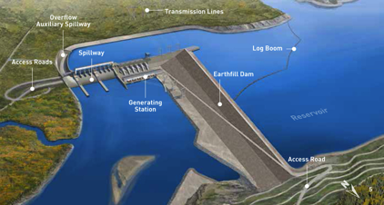
You are head of Engineering for a large dam project on the Yellow river in the Ningxai province of China. The dam is to be located in the Yiling district near the exit of the Ordos Loop section of the river. The dam is to be located at 34°49′46″N 111°20′41″E. The Yellow river is China’s third largest river. The river is characterized by extremely high silt loads, especially in spring floods. The local bedrock is highly fractured gneiss. The dam will be a concrete earthfill hybrid design. You have been asked to determine some of the main design parameters, including safety related question like what flood event return period to build the dam to withstand.
What flood return period would you recommend the dam be designed to withstand?
once in 50 year flood
once in 100 year flood
once in 200 year flood
once in 500 year flood

Slide 26
Design our courses backwards with clear learning outcomes that make other course decisions easier – how to teach and how to assess
Notes:
Tell Amanda Story

Slide 27
Build Well-constructed, Measurable, Vibrant Learning Outcomes
Start simply with a Bloom’s Verb and piece of Content*
Try to rewrite Learning Outcomes to higher Bloom’s level
Use steps to make Learning Outcomes more Vibrant
Make sure Learning Outcomes are measurable - a well constructed Learning Outcome both helps you select Teaching and Learning Activities and construct fair and rigorous Assessments
Notes:
Eventually we want to move to creating LO about who we want student be be able to do at end of course – but it is OK to start where we often find ourselves surrounded by content we need to “cover”

Slide 28
Outcomes

Slide 29
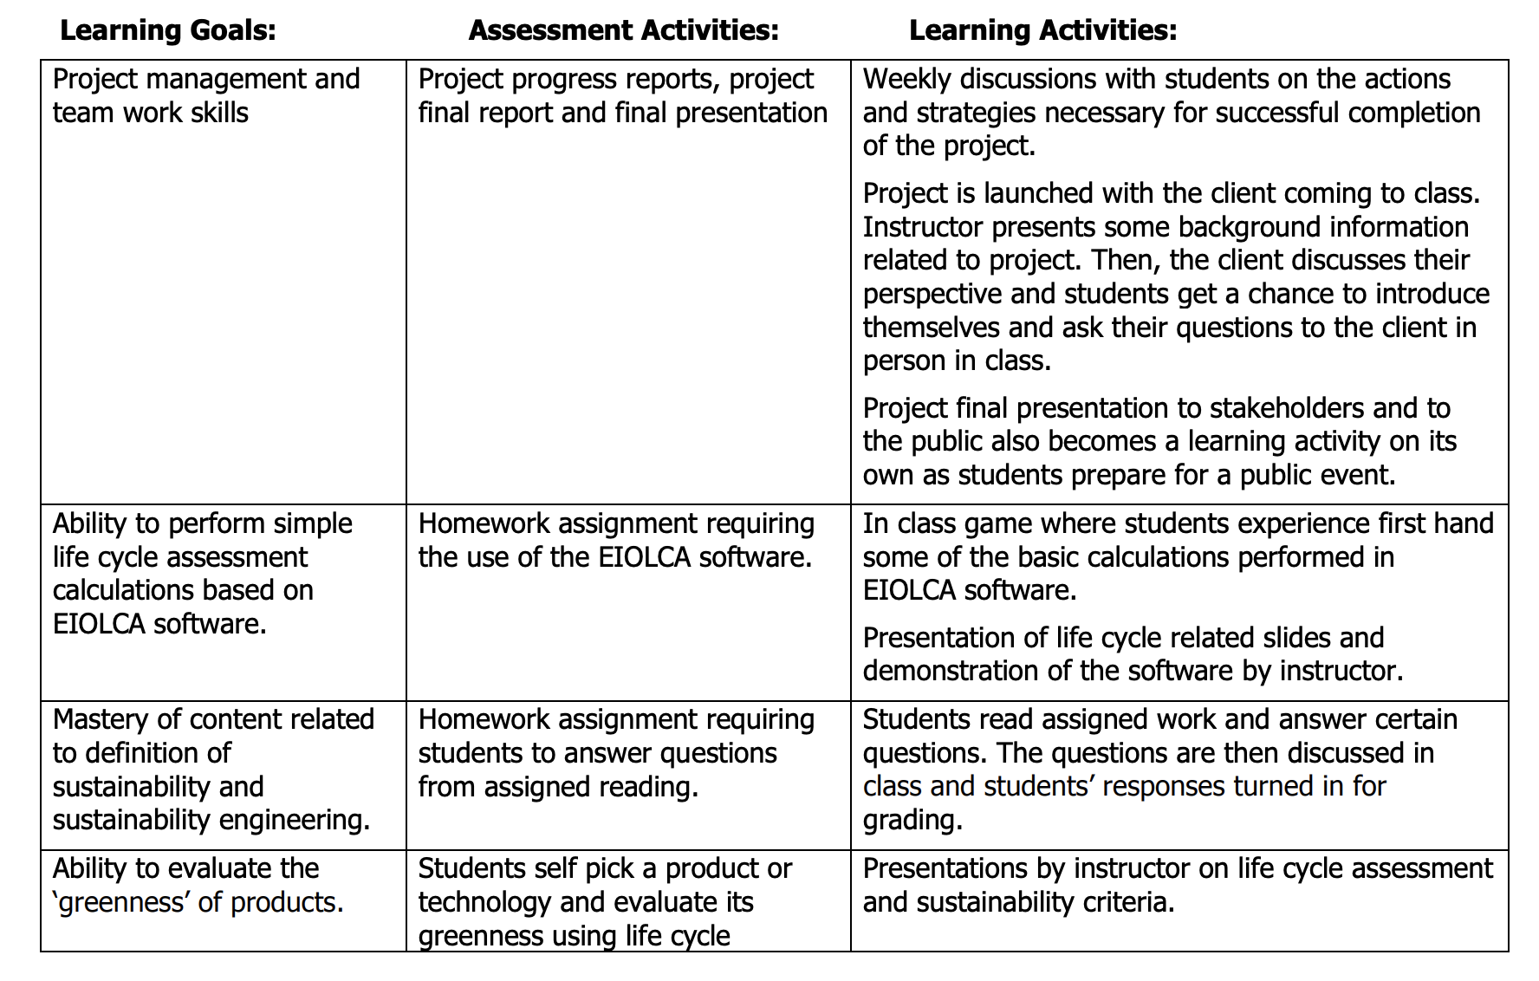
Using Fink’s 3 Column Table
To bring course level detail to Fink Triad concept
Engineering Sustainability
Notes:
Fink’s online course

Slide 30


Notes:
Uncover content rather then cover content – I love the Wiggins and McThige idea from their book Understanding by design

Slide 31
Questions
jim.sibley@ubc.ca

Slide 32
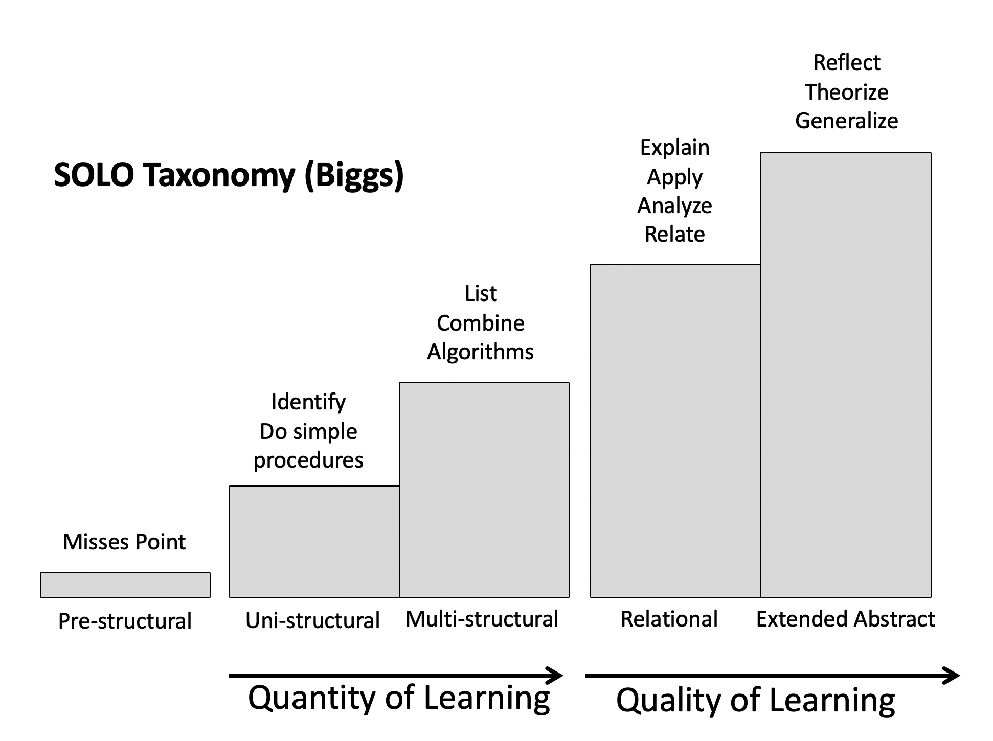

Slide 33
Learning Goals
Teaching and Learning Activities
Feedback and Assessment

