Slide 1
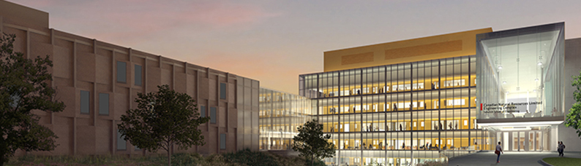
Introduction to
Team-Based Learning
Jim Sibley
Director – Centre for Instructional Support
University of British Columbia
February 19, 2019

Slide 2
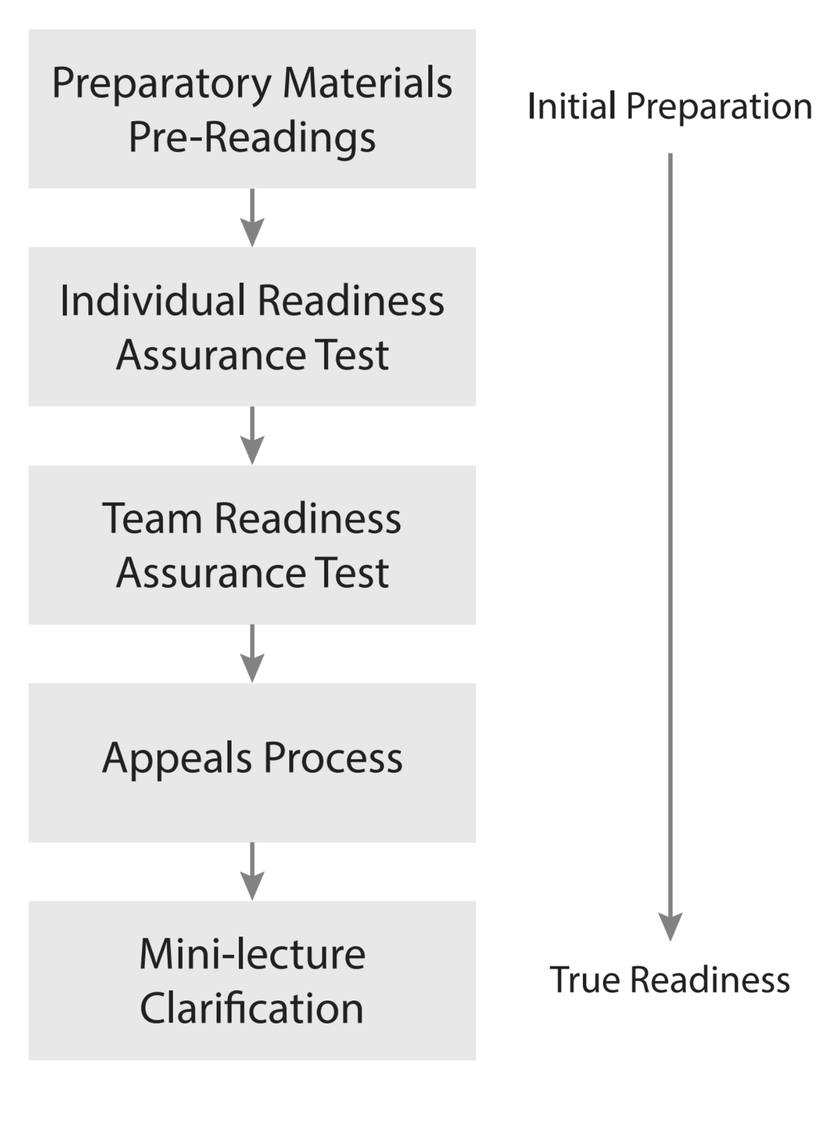
Readiness Assurance Process

Slide 3

Reading before Class

Slide 4
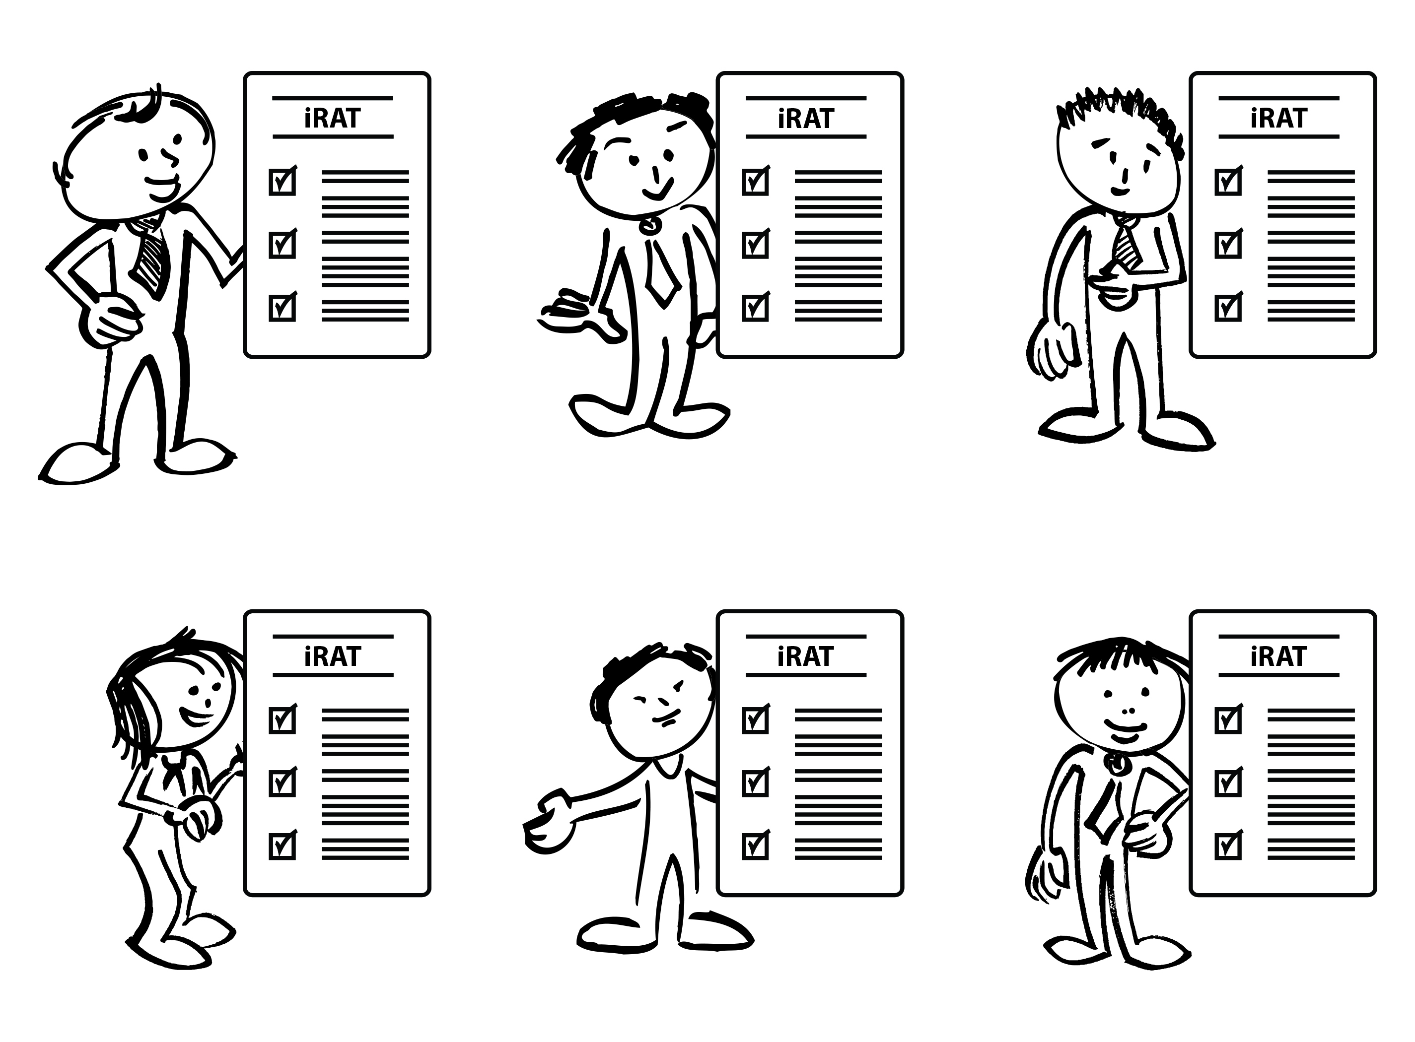
Individual Readiness Assurance Test

Slide 5
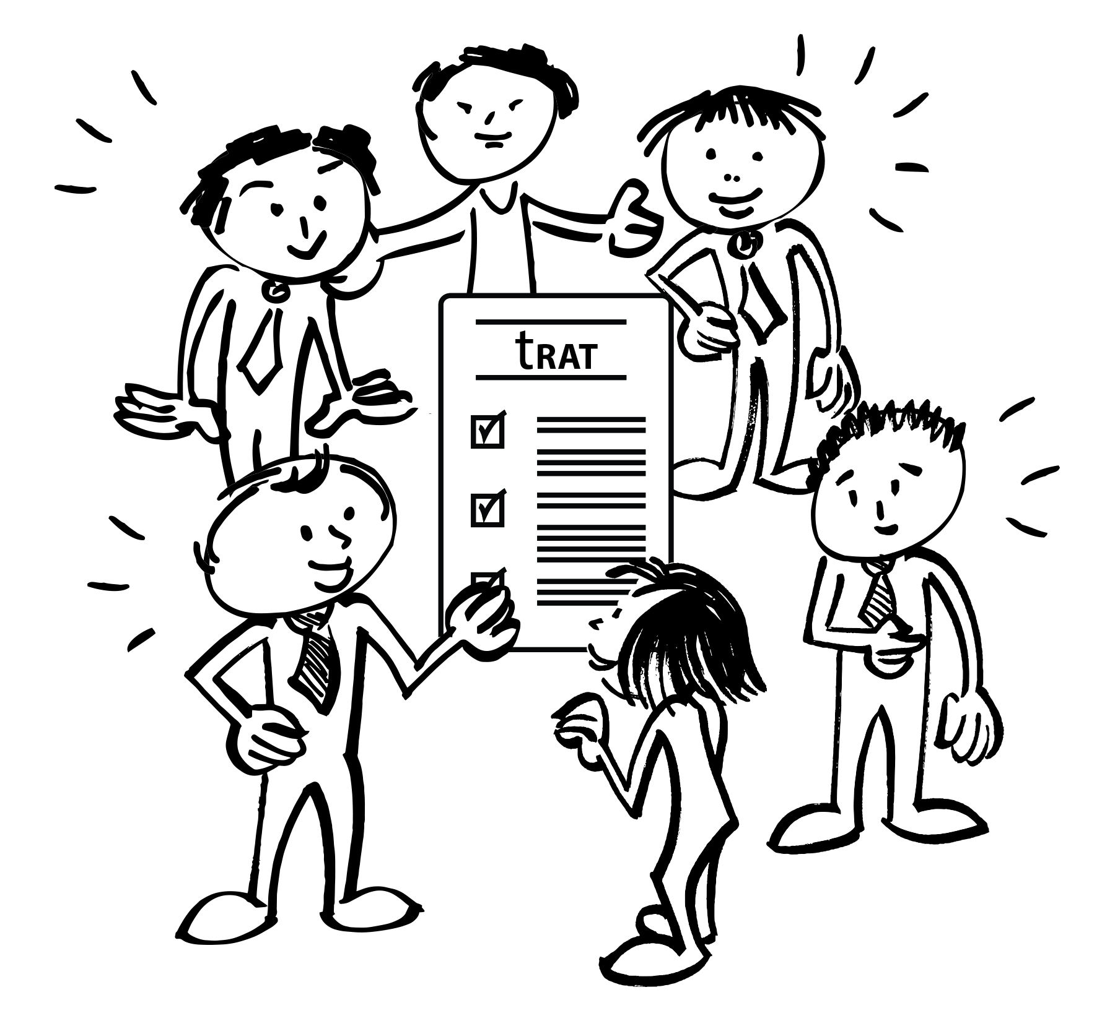
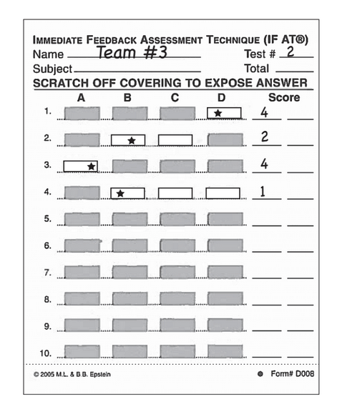
Team Readiness Assurance Test

Slide 6
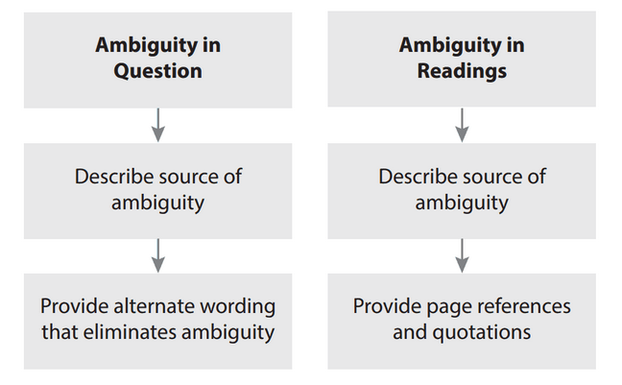
Appeals Process

Slide 7
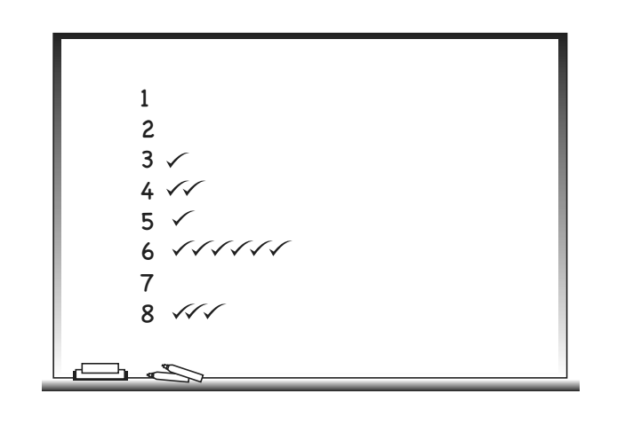
Mini- Lecture/Instructor Clarification

Slide 9
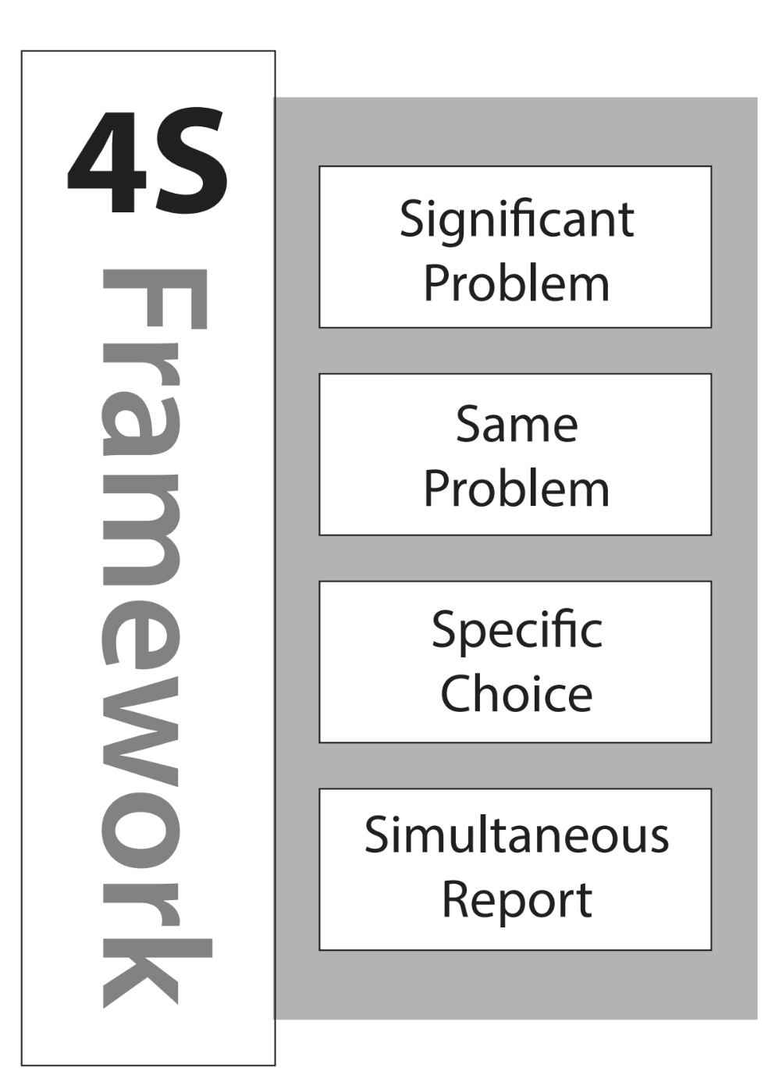
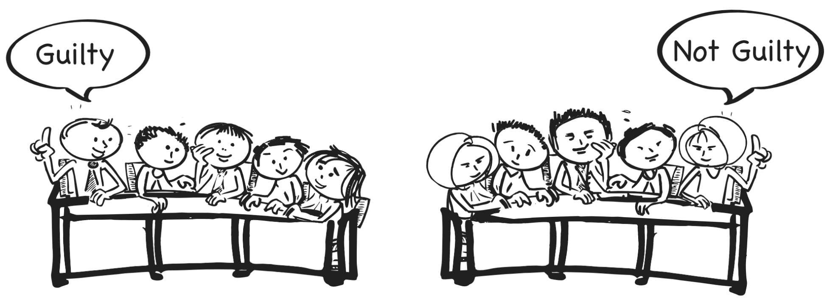

Slide 10
Creating Proper Conditions
Team formation
Accountability
Feedback
Using TBL Protocols
Readiness Assurance
Decision Making using 4S’s

Slide 11
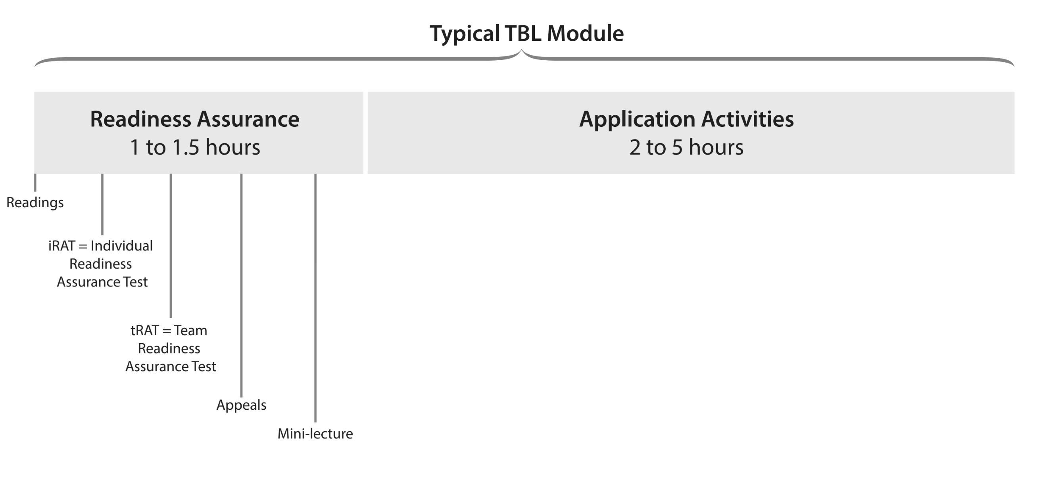

Slide 12
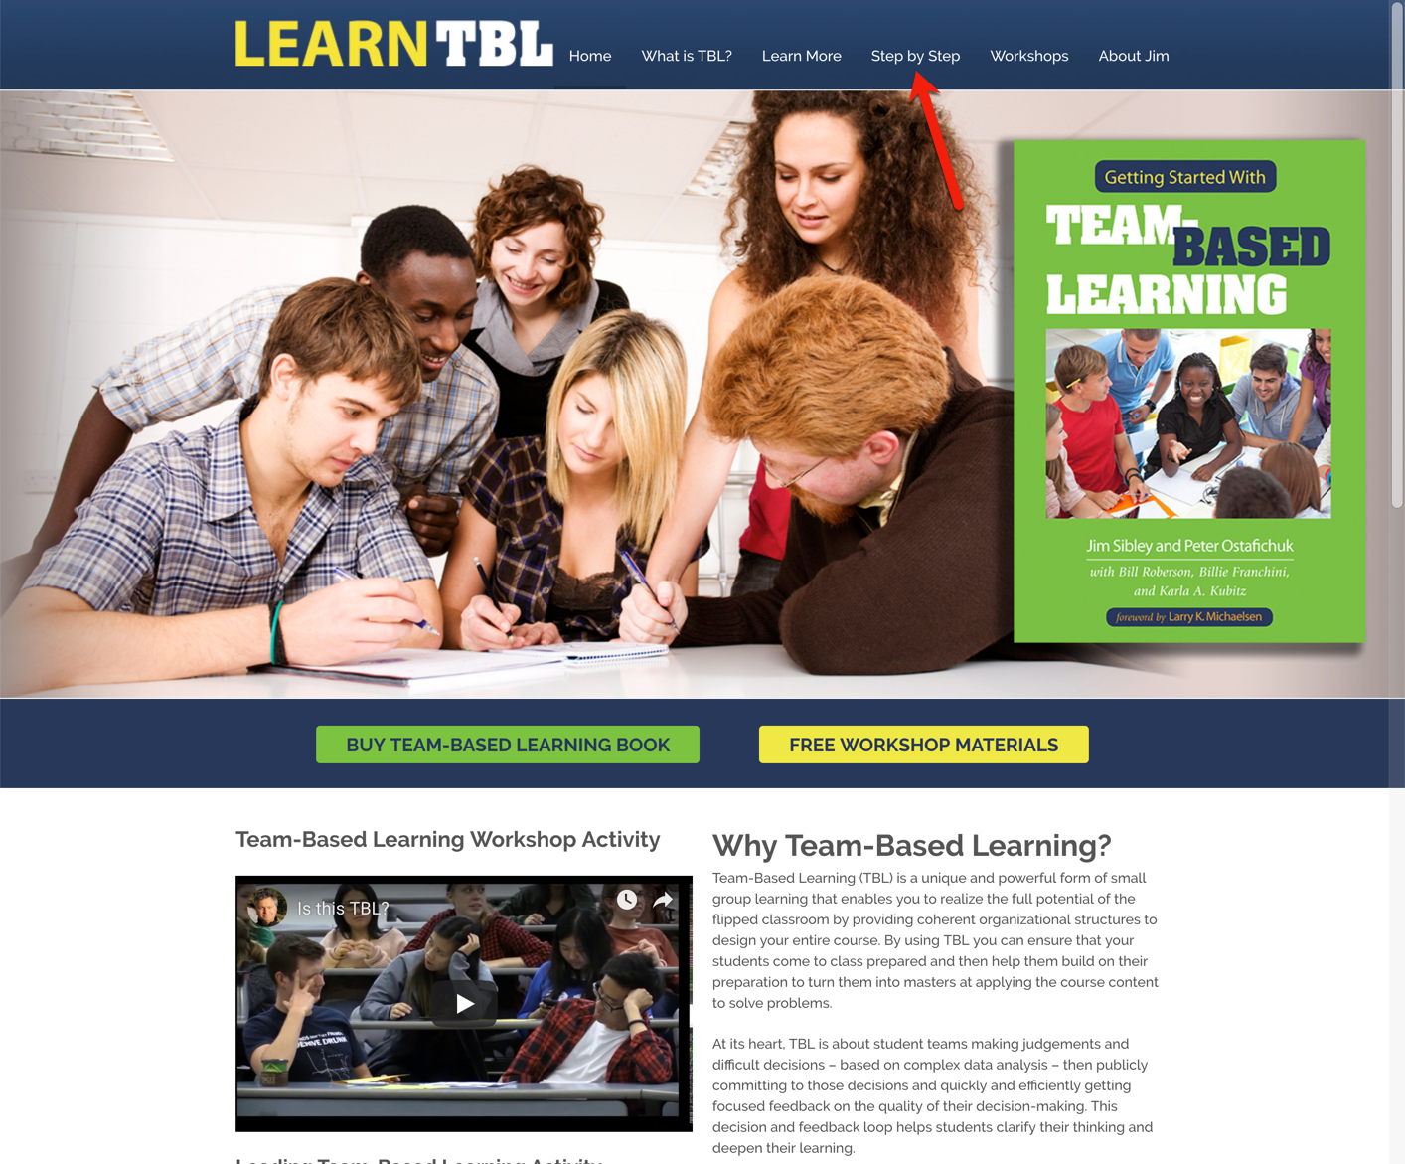
learntbl.ca

Slide 13
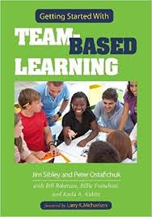
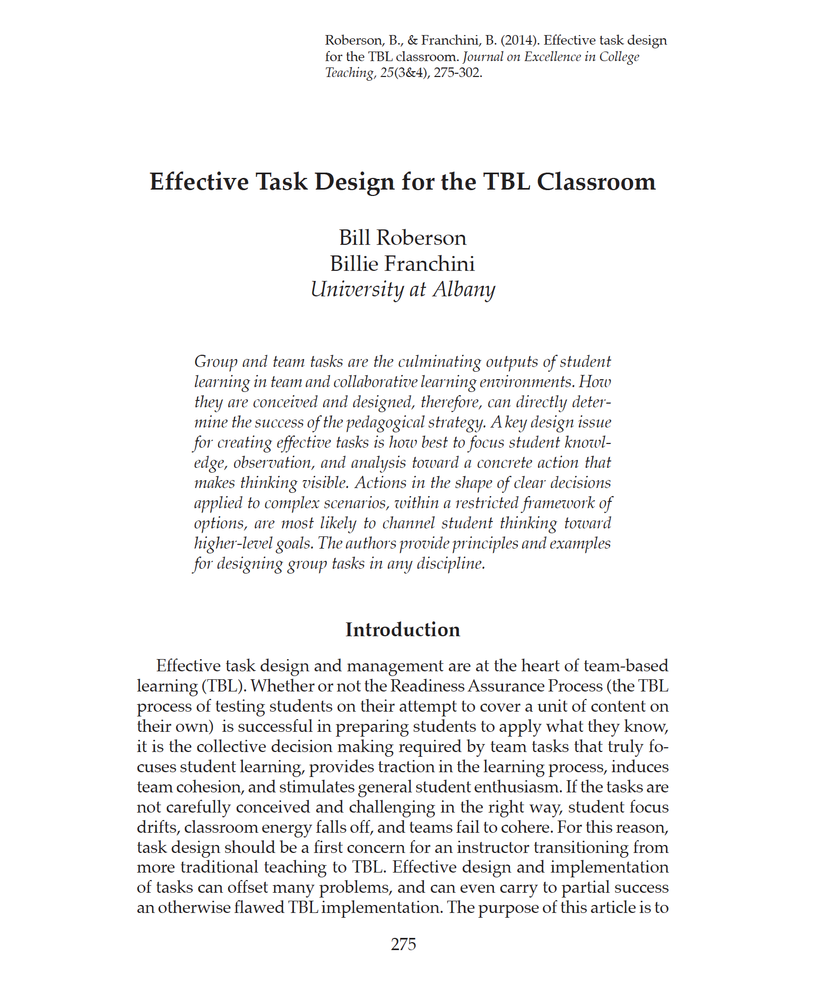
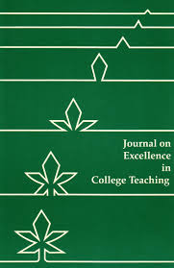
Notes:
Uncover content rather then cover content – I love the Wiggins and McThige idea from their book Understanding by design

Slide 14
Questions
jim.sibley@ubc.ca

