Slide 1

Building Great
Classroom Activities
Jim Sibley
Director – Centre for Instructional Support
University of British Columbia
February 19, 2019

Slide 2
What makes a classroom activity/discussion great?
Notes:
Energy, everyone engaged, depth of conversation, taking work seriously, students looking things up, explaining to each other, making important insights, connections

Slide 3
Energy
Excitement
Engagement
Explaining to each other
Looking stuff up
Making connections
Having insights
Task Focused
Content Focused

Slide 4
Learning Outcomes
Explain why constraining choice for activities is important
Explain why making a specific decision is important
Name the 4 S’s of the 4S problem-solving model
Explain why simultaneous reporting is critical
Design a simple constrained problem using a superlative

Slide 5
What would you do in this situation?
What would you do first in this situation?
Which of these would you do first in this situation?
Constraint is what intensifies discourse

Slide 6
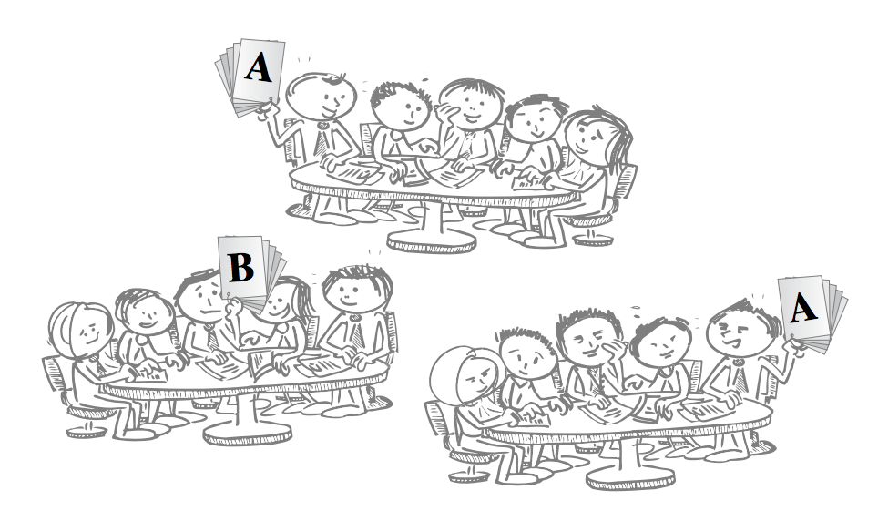
Decisions give visible form to students thinking and use of knowledge

Slide 7
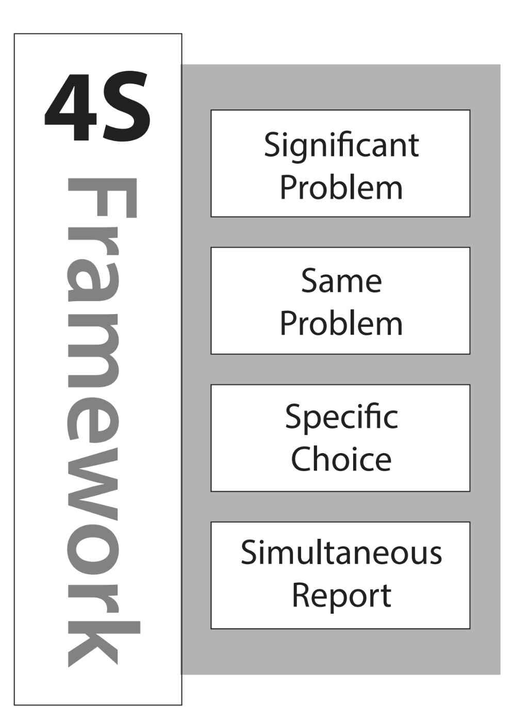

Notes:
Read page 1-2

Slide 8
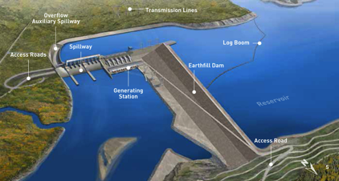
You are head of Engineering for a large dam project on the Yellow river in the Ningxai province of China. The dam is to be located in the Yiling district near the exit of the Ordos Loop section of the river. The dam is to be located at 34°49′46″N 111°20′41″E. The Yellow river is China’s third largest river. The river is characterized by extremely high silt loads, especially in spring floods. The local bedrock is highly fractured gneiss. The dam will be a concrete earthfill hybrid design. You have been asked to determine some of the main design parameters, including safety related questions like what flood event return period to build the dam to withstand.
What flood return period would you recommend the dam be designed to withstand?
once in 50 year flood
once in 100 year flood
once in 200 year flood
once in 500 year flood

Slide 9
Are they really just multiple-choice questions?
Complex data, complex decisions, simple report

Slide 10
You are head of Engineering for a large dam project on the Yellow river in the Ningxai province of China. The dam is to be located in the Yiling district near the exit of the Ordos Loop section of the river. The dam is to be located at 34°49′46″N 111°20′41″E. The Yellow river is China’s third largest river. The river is characterized by extremely high silt loads, especially in spring floods. The local bedrock is highly fractured gneiss. The dam will be a concrete earthfill hybrid design. You have been asked to determine some of the main design parameters, including safety related questions like what flood event return period to build the dam to withstand.
What flood return period would you recommend the dam be designed to withstand?
once in 50 year flood
once in 100 year flood
once in 200 year flood
once in 500 year flood
Complex Data
Complex Decision
Simple Report

Slide 11
A patient with a Brain Stem Stroke has collapsed a lung from intractable hiccups and feed-tube aspirates. He was admitted to intensive care to deal with the subsequent pneumonia. A few weeks later he is moved to a regular ward and the PRN order for Baclofen has expired (Baclofen, Gabapentin family of drugs - off label use to control intractable hiccups). The patient has begun to hiccup again and is growing increasingly distressed that nothing is being done. The patient’s wife has repeatedly come to the nurse’s station demanding action. It is Friday night of a long weekend and the doctor on call is not returning the page. The Doctor had made is very clear to the nurses, that he is not to be called. It appears to be a doctor oversight that it was not renewed. The wife persistently demands action and the nurse begins to cry. The head nurse intervenes.
The head nurse should:
  Do nothing, but continue to attempt to contact the doctor
  Give the patient the pill and note it in the chart
  Give the pill, chart it, and continue calling the doctor
  Mark a pill as spoiled and leave it with the patient
Complex Data
Complex Decision
Simple Report

Slide 12
Read Page 1-2

Slide 13

Constrained choice intensify discourse

Slide 14
Think about a topic/concept/abstraction that your students have difficulty applying to real world contexts

Slide 15
Pick a Specific, concrete decision that requires judgment
Evaluate something
(product, statement, resource, market, argument…)
Assess/diagnosis something
(situation, patient…)
Predict something
(probable consequence of an action…)
Recommend something
(how to avoid damage, bankruptcy, incarceration, disaster…)
Notes:
Energy, everyone engaged, depth of conversation, taking work seriously, students looking things up, explaining to each other, making important insights, connections

Slide 16
Create story about a situation that brings students to a decision point
  You go into the supermarket and see 8 brands of cheese…
  Here’s a picture of a client who just walked into
  your hair salon…
  Here are three letters by applicants for director of…
  Here is 3 articles on the defunding of education
  from local newspapers
  Here are 3 paragraphs about X by 3 different authors…
  Here’s a new product that needs testing…
Notes:
Energy, everyone engaged, depth of conversation, taking work seriously, students looking things up, explaining to each other, making important insights, connections

Slide 17
Write a prompt as a DECISION or CHOICE needed in response to a situation - that naturally elicit why this and not that?
  Which of the options presented is best/worst?
  What would you do first/last?
  Which of these items will be most/least effective?
  What will be the most likely outcome/consequence of…?
  How would you rank these?
  What score would you give this?
Notes:
Energy, everyone engaged, depth of conversation, taking work seriously, students looking things up, explaining to each other, making important insights, connections

Slide 18
Write Your First 4S Activity (10 minutes)
First think the kind of decisions/judgments you want your student to be able to do
Create a story that naturally brings students to a decision point in a specific context/situation
Create decision prompt and constrained choices (reasonable, plausible, ccompetitive)– things are contextually sensitive are best
Go prompt shopping from list on Page 3 and 4
10
mins
Use blank sheet of paper and prompts from page 2

Slide 19
Read Page 3-4

Slide 20
Share your draft activity with your tablemates.
Read your activity to your tablemates - highlighting the judgment/decision you want students to make, the specific concrete application situation that leads to a natural decision point, and the question prompt (with superlative) and the kinds of specific choices they will consider (~2.5 minutes per person)
10
mins
For next 10 minutes

Slide 21
Shape of Constrained Decision Activity
Concrete situation description
Question
Prompt
Something to analyze – to understand more about situation
Stories, images, evidence, articles, charts, data sets, test results, text passages
A decision to be made - question with a superlative so teams are forced to make a decision and pick one option - rank, score, sort, best, worst, cheapest, most efficient, first, last, etc.
A. One possible, plausible, competitive course of action/decision
Possible decisions
B. Another possible, plausible, competitive course of action/decision
C. Another possible, plausible, competitive course of action/decision
D. Another possible, plausible, competitive course of action/decision

Slide 22
You are head of Engineering for a large dam project on the Yellow river in the Ningxai province of China. The dam is to be located in the Yiling district near the exit of the Ordos Loop section of the river. The dam is to be located at 34°49′46″N 111°20′41″E. The Yellow river is China’s third largest river. The river is characterized by extremely high silt loads, especially in spring floods. The local bedrock is highly fractured gneiss. The dam will be a concrete earthfill hybrid design. You have been asked to determine some of the main design parameters, including safety related questions like what flood event return period to build the dam to withstand.
What flood return period would you recommend the dam be designed to withstand?
once in 50 year flood
once in 100 year flood
once in 200 year flood
once in 500 year flood

Slide 23

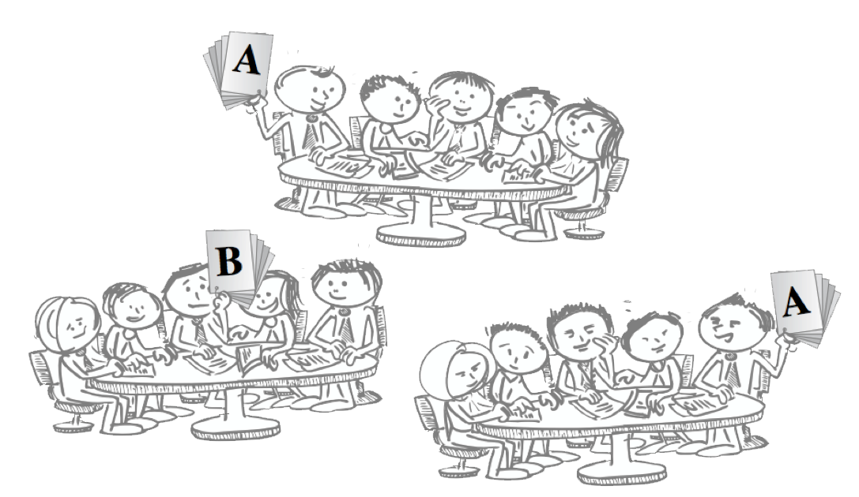
Notes:
Public report of decisions give visible form to students thinking and application of knowledge. Allows everyone to compare thinking. Powerful discussion primer when differences are made visible.

Slide 24
A patient come into emergency with the following symptoms... …add appropriately COMPLEX SCENARIO and DATA here
Possible 4S: What is the first thing you would do? And why?
  Possible 4S: What is the first test you would order? And why
  Possible 4S: What would be the worst thing to do? And why?

Slide 25
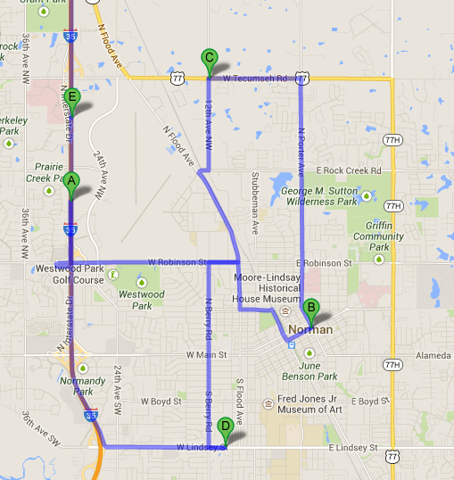
You are consulting for a new business owner who wants to open a dry-cleaning store in Norman, Oklahoma.
Where would you recommend locating a new dry-cleaning business (and why)?
Push Pin in Map

Slide 26
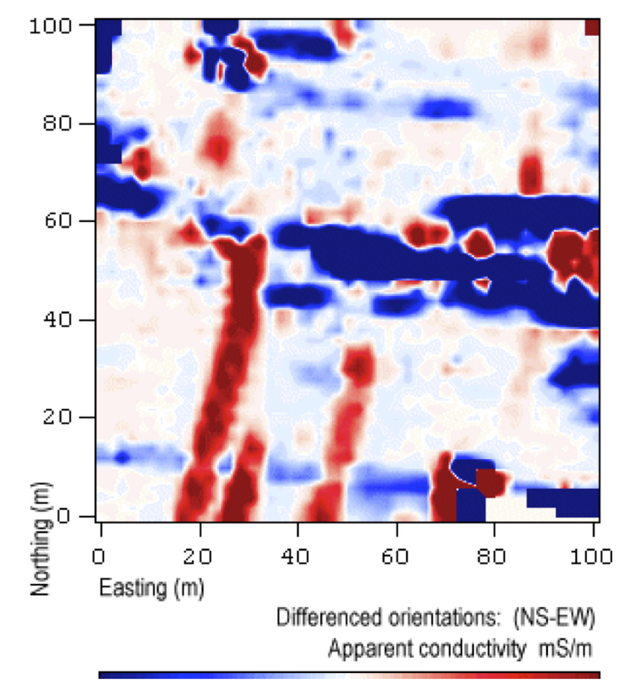
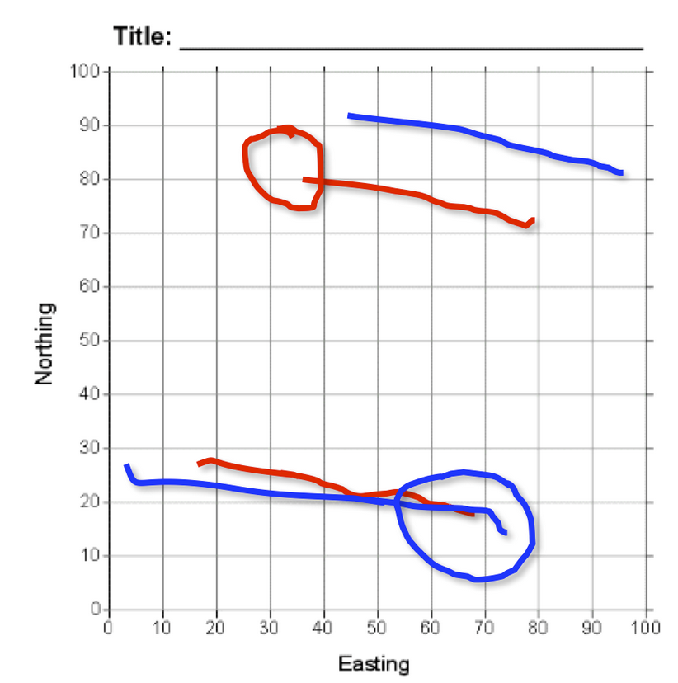
The image on the left is the original data graphic provided to teams, and the image on the right is an overlay of the responses from two teams, each using their own color. Teams were required to interpret the data by identifying two linear features with lines and the location of one additional feature with a circle.
Stacked Overheads
Jones, 2009

Slide 27
Instructor enters numerical positions then displays all at once
One page summary– principles and approach and not calculations (16 point font or bigger)
Excel Charts

Slide 28
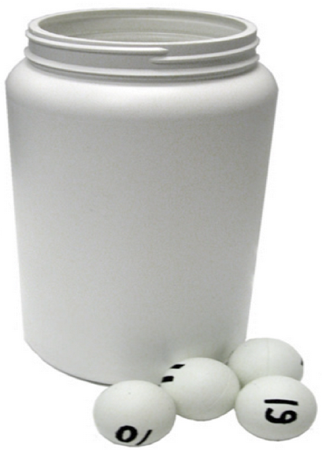
Hot Seat

Slide 29
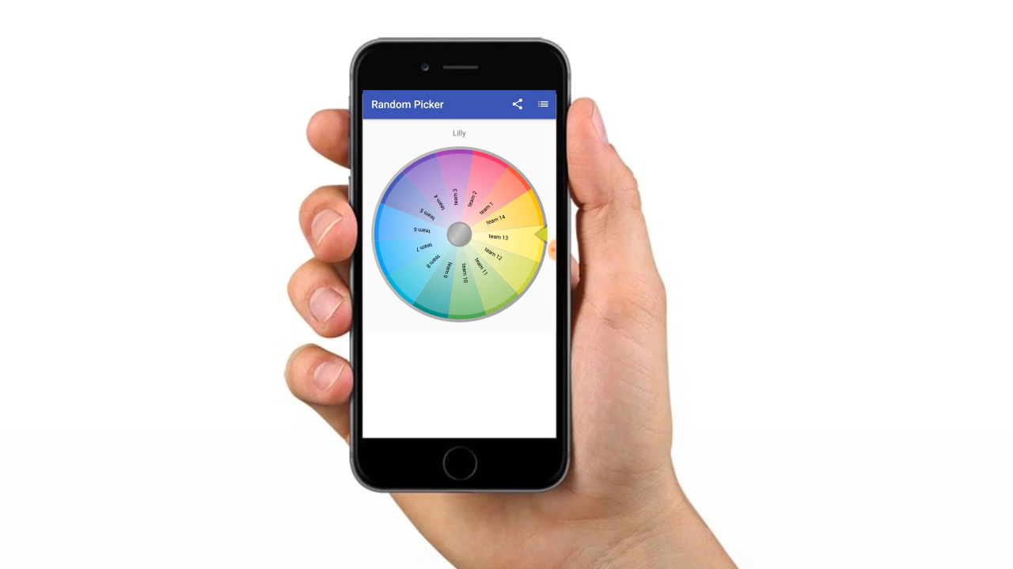
The Wheel of Motivation
Notes:
Team 5

Slide 31


Slide 32
Questions
jim.sibley@ubc.ca

Slide 33
Dotmocracy

